Slide 1
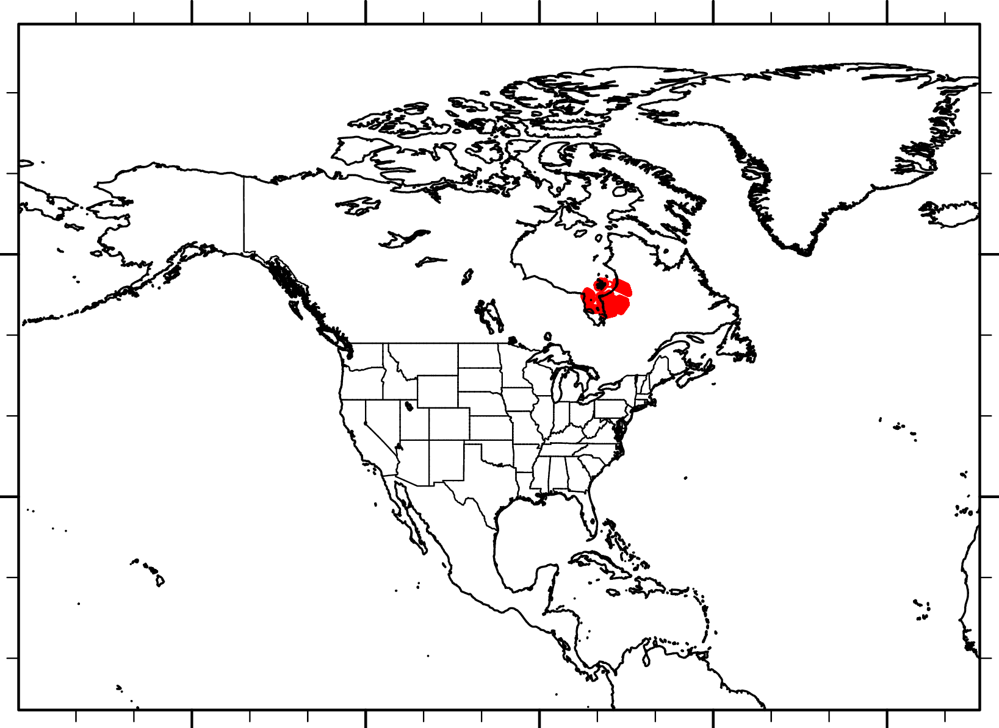
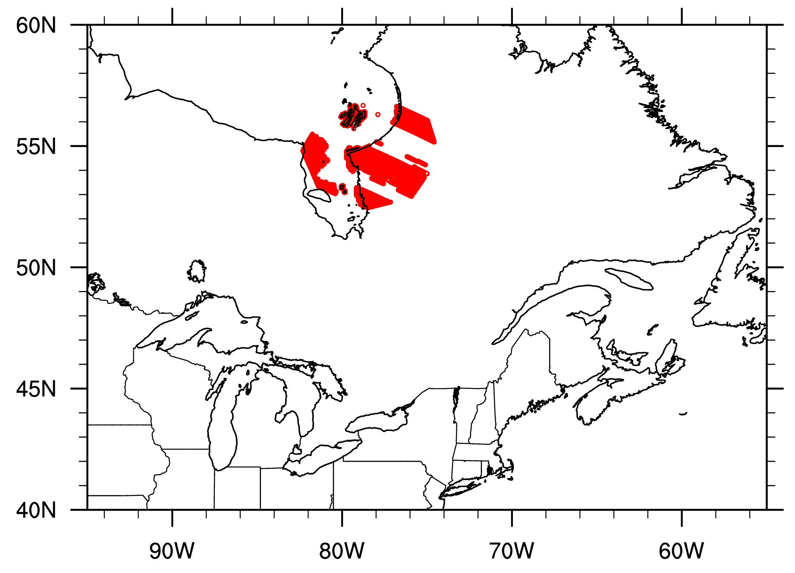
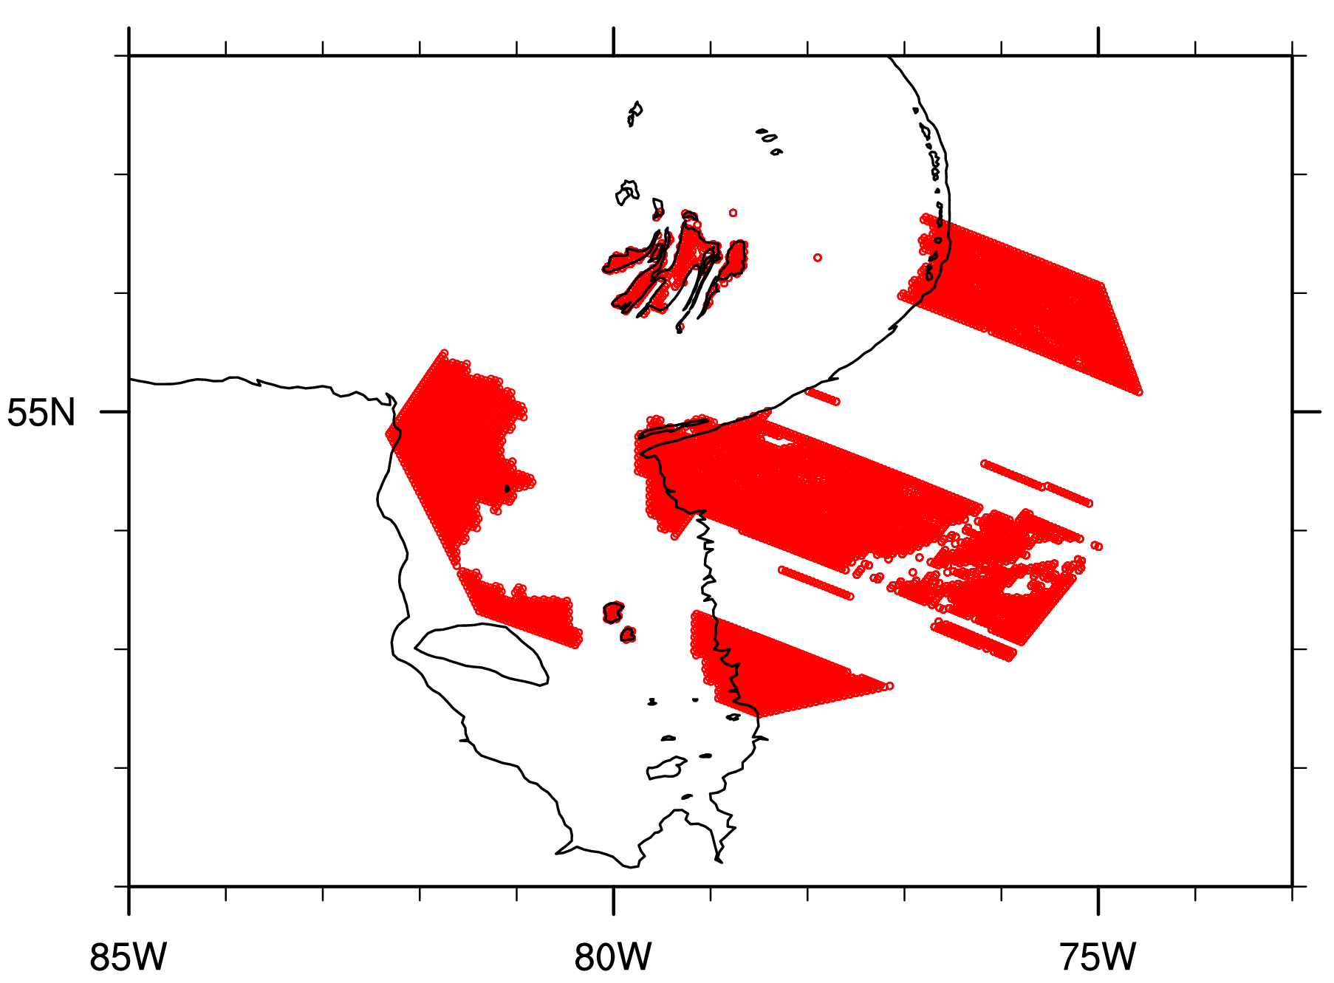
RRFS ensemble member crashed with AVOST error from RUC LSM after ~12 timesteps
Only happens to GFS PBL/sfclay+clm lake over north America domain in winter
- GFS PBL/sfclay+no clm lake over north America domain in winter is good
- GFS PBL/sfclay+clm lake over CONUS domain in warm season is good
- MYNN PBL/sfclay+clm lake over north America domain in winter is good
Error message locations

Slide 2
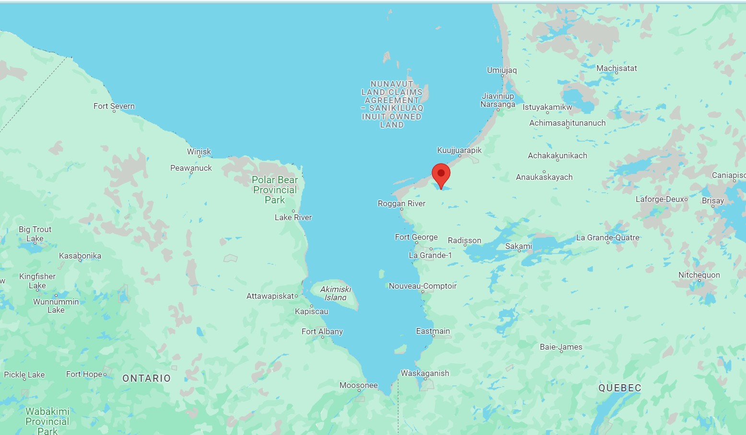
At timestep 11, lake ice fraction on this particular grid point changes from 0 to 0.150077661202128 (lake water-> lake ice)
Icy (lake ice flag) is changed from F to T for this grid;
forcing ice flag of this grid to be false can avoid crash

Slide 3
ccpp suite SDF
…
<!-- Surface iteration loop -->
<subcycle loop="2">
<scheme>sfc_diff</scheme> (GFS sfclay)
<scheme>GFS_surface_loop_control_part1</scheme>
<scheme>sfc_ocean</scheme>
<scheme>lsm_ruc</scheme>
<scheme>clm_lake</scheme>
<scheme>GFS_surface_loop_control_part2</scheme>
</subcycle>
<!-- End of surface iteration loop -->
<subcycle loop="1">
<scheme>GFS_surface_composites_post</scheme>
<scheme>sfc_diag</scheme>
<scheme>sfc_diag_post</scheme>
<scheme>GFS_surface_generic_post</scheme>
<scheme>GFS_PBL_generic_pre</scheme>
<scheme>satmedmfvdifq</scheme>
<scheme>GFS_PBL_generic_post</scheme>
…
Ice flag changed from false to true for a grid point
do i = 1, im
flag_iter(i) = .false.
flag_guess(i) = .false.
if (iter == 1 .and. wind(i) < 2.0d0) then
!if (dry(i) .or. (wet(i) .and. .not.icy(i) .and. nstf_name1 > 0)) then
if((dry(i) .and. lsm /= lsm_noahmp) .or. (wet(i) .and. nstf_name1 > 0)) then
flag_iter(i) = .true.
endif
endif
enddo
Flag_iter is the flag to control whether a subroutine will run in a ccpp loop;
only true for land and ocean points (if nsst is on)

Slide 4
ccpp suite SDF
…
<!-- Surface iteration loop -->
<subcycle loop="2">
<scheme>sfc_diff</scheme> (GFS sfclay)
<scheme>GFS_surface_loop_control_part1</scheme>
<scheme>sfc_ocean</scheme>
<scheme>lsm_ruc</scheme>
<scheme>clm_lake</scheme>
<scheme>GFS_surface_loop_control_part2</scheme>
</subcycle>
<!-- End of surface iteration loop -->
<subcycle loop="1">
<scheme>GFS_surface_composites_post</scheme>
<scheme>sfc_diag</scheme>
<scheme>sfc_diag_post</scheme>
<scheme>GFS_surface_generic_post</scheme>
<scheme>GFS_PBL_generic_pre</scheme>
<scheme>satmedmfvdifq</scheme>
<scheme>GFS_PBL_generic_post</scheme>
…
In the second iteration/run, GFS sfclay only goes through land points.
do i=1,im
if(flag_iter(i) ) then
…
if (icy(i)) then ! Some ice
…
call stability
! --- inputs:
& (z1(i), zvfun(i), gdx, tv1, thv1, wind(i),
& z0max, ztmax_ice(i), tvs, grav, thsfc_loc,
! --- outputs:
& rb_ice(i), fm_ice(i), fh_ice(i), fm10_ice(i), fh2_ice(i),
& cm_ice(i), ch_ice(i), stress_ice(i), ustar_ice(i))
rb_ice(i), fm_ice(i), fh_ice(i), fm10_ice(i), fh2_ice(i),
cm_ice(i), ch_ice(i), stress_ice(i), ustar_ice(i))
All the above values for ice (drag coef, stress, ustar, similarity function, Rb) are missing for the grid point when changing from non-ice to ice in clm lake

Slide 5
One possible solution:
add a flag to force GFS sfclay to run a second time through grid points when there is a status change in clm lake (water->ice or ice->water)
Clm lake:
Sfc_diff:
ice_point: if(fice(i)>=min_lakeice) then
…
if (icy(i) .eq. .false.) then
lake_change(i)=.true.
end if
icy(i)=.true.
…
else
if (icy(i) .eq. .true.) then
lake_change(i)=.true.
end if
icy(i)=.false.
do i=1,im
if(flag_iter(i) .or. lake_change(i)) then
Run was successful for 5.7 hours forecast before hitting debug walltime

Slide 6
Another possible solution:
Don’t change ice flag “icy” in clm lake
It will be reset in next timestep in GFS_surface_composites_pre based on updated lake ice fraction
if(fice(i) < cimin(i)) then
fraci(i) = f_zero
icy(i) = .false.
else
fraci(i) = fraco(i) * fice(i)
icy(i) = .true.
endif
<group name="radiation">
<subcycle loop="1">
…
<scheme>GFS_radiation_surface</scheme>
…
</subcycle>
</group>
<group name="physics">
<subcycle loop="1">
…
<scheme>GFS_surface_composites_pre</scheme>
<scheme>dcyc2t3</scheme>
…
</subcycle>
<!-- Surface iteration loop -->
<subcycle loop="2">
<scheme>sfc_diff</scheme>
<scheme>GFS_surface_loop_control_part1</scheme>
<scheme>sfc_ocean</scheme>
<scheme>lsm_ruc</scheme>
<scheme>clm_lake</scheme>
<scheme>GFS_surface_loop_control_part2</scheme>
</subcycle>
…
Here “icy” is local
if (cice(i) >= min_lakeice) then
icy(i) = .true.
Run was successful for 5.7 hours forecast before hitting debug walltime

