Slide 1
Features
[in, out]
[user_check]
[count]
[size]
[readonly]
[isptr]
[string]
[isary]
public keyword
include statements
struct - enum definitions
allow keyword

Slide 2
Features
[in, out]
[user_check]
[count]
[size]
[readonly]
[isptr]
[string]
[isary]
public keyword
include statements
struct - enum definitions
allow keyword

Slide 3
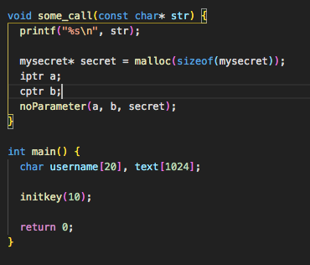
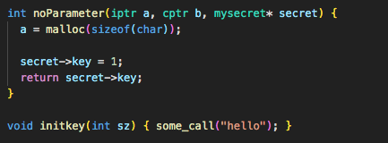
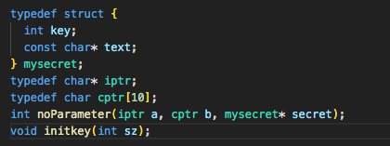

Slide 4
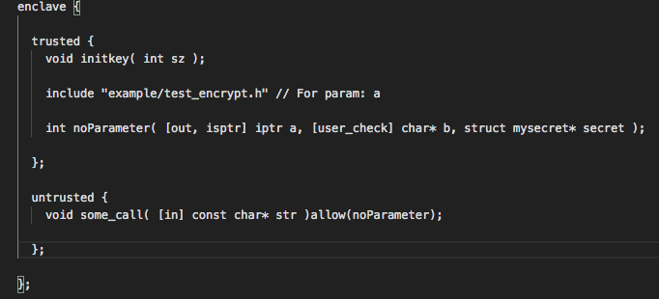

Slide 5
[In – out]
From AccessInfoTracker
Currently not supporting struct.
For pointers there are two nodes: pointer and base.

Slide 6
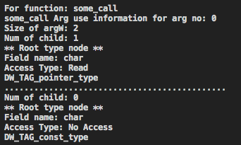
[In – out]
The pointer is used in a load, so we have the in attribute.

Slide 7
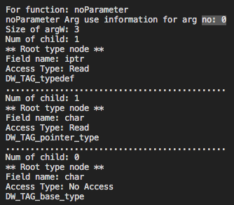
[In – out]
The pointer is used in a load, we have [in] attribute.
iptr is a char* in this example.

Slide 8
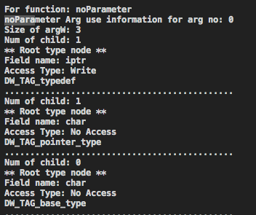
[In – out]
The pointer is used in a store we have [out] attribute.
iptr is a char* in this example.

Slide 9
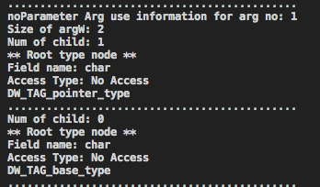
[user_check]
Pointers have to have direction attribute, if we don’t find any access type, they default to user_check.

Slide 10
[ISPTR]
User defined typedef pointers have this attribute to annotate to EDL that this type is in fact a pointer.

Slide 11
[READ_ONLY]
Typedef pointers with const qualifier gets this attribute. isptr attribute has to be included here.

Slide 12
[ISARy]
User defined typedef arrays should have this pointer.
LLVM uses DW_TAG_pointer_type directly instead of DW_TAG_typedef. We lose the static size information and the typedeffed type.

Slide 13
Allow keyword
A function from untrusted side is an OCALL if it is called from a function inside trusted side.
In our example some_call(const char* str) is an OCALL because it is called inside initkey(int sz) which is an ECALL.
OCALLs can only call the functions that are explicitly allowed with the allow() syntax.
Generating the untrusted { }; in EDL, we allow a function that is found in the transitive closure of an OCALL if that function is cross boundary.

Slide 14
PUBLIC KEYWORD
There has to be at least one public (root) ECALL. Public ECALLs can be called from untrusted domain. (Not OCALLs, the untrusted part).
We analyze Call Graph to find all root ECALL functions and add that information to the EDL we create.

Slide 15
INCLUDE for user defined types
Currently arguments with typedef trigger include statements in EDL.

Slide 16
StructS
Access info tracking for structs are not supported yet.
Structs types can be declared by including a header that declares them like typedef or directly declared inside EDL.
We can have deep copy struct by declaring them in EDL. This can be generated from DI in LLVM.
Such as

Slide 17
Simple project to SGX automatize
There is an enclave initialization function. Included from “sgx_urts.h”
global_eid of type sgx_enclave_id_t (uint64_t). This value is sent to ECALL calls.
ECALLs return sgx_status_t to check whether the ecall was successful.
Real return values of ECALLs are sent as the second parameter.
Two header files are required: “Enclave_t.h” and ”Enclave_u.h”.

Slide 18
Simple project to SGX automatize
The trusted side (enclave) does not need any changes. OCALL calls don’t have special syntax.
Using debug information, we can inject the include statements for headers and the necessary changes to function calls and the initialization of the enclave.
Most important change we need to do is:
Add necessary headers to both sides and add a global variable of type sgx_enclave_id_t to the untrusted domain. This variable will be used in the ECALLs.
Add the global_eid parameter to each ECALL function.
Currently we don’t handle ECALLs with return types other than void. We need to analyze how the return value is used and send a second parameter as reference to the ECALL to get return values from the ECALLs.

Slide 19
Simple project to SGX automatize
SGXGenerator pass in the project analyzes the debug information and injects enclave initialization code into the main function.
It also defines the following:
sgx_enclave_id_t global_eid = 0;
The above variable then gets sent to each ECALL function in the untrusted domain. The location to inject that parameter is found via debug information again.
Finally some headers necessary for SGX gets injected to both trusted and untrusted domains.

Slide 20
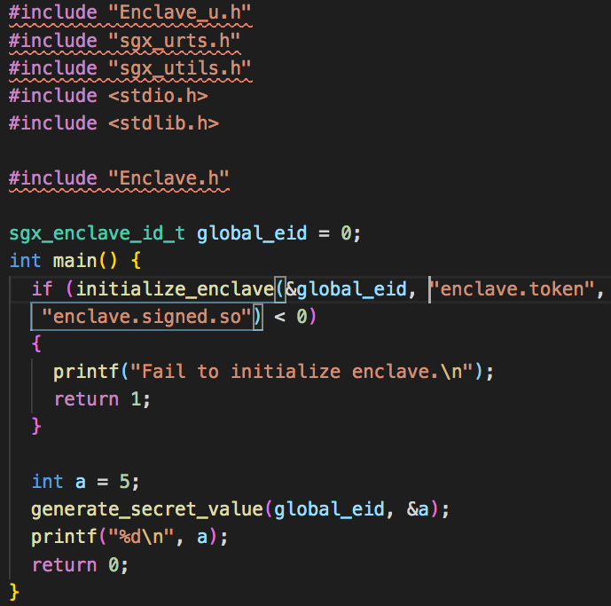
ConvertED to =>

Slide 21
Next steps - INCLUDE
The include statement should be at the top of a scope in an EDL. Will rewrite include statement generation.
Try to analyze local variables too for include statements.
The relative path of the file might need to be fixed.
Include should also handle struct types if they are defined in the file.

Slide 22
Next steps - STRUCTs
Access info tracking.
Struct declarations in EDL can have attributed buffers. We can get elements of the struct from LLVM DI and declare the struct in EDL with appropriate attributes and types.

Slide 23
Next steps – COUNT SIZE STRING
Need to analyze argument usage and possibly the caller to deduce count, size, and string attributes.
STRING: typical str library functions
The total buffer size is count * size. SGX does not allow arbitrary size. It has to be a multiple of sizeof(argType).
If size is not specified, then the buffer size is calculated using the above formula where size is sizeof (element pointed by the pointer). This seems fine for most types other than void. For void pointers size attribute is required.

