Slide 1
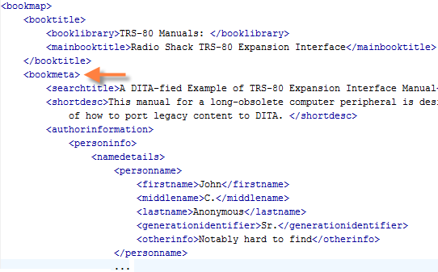
DITA and Metadata
Metadata can be incorporated at both the map and topic levels
Bookmaps use the bookmeta and topicmeta elements as containers
Topics incorporate metadata within the prolog
This content along is then expressed at output primarily as Dublin Core metadata
Bookmap
Topic
Notes:
A subjectSchema can also be created/used to automatically create metadata in the DITA source content

Slide 2
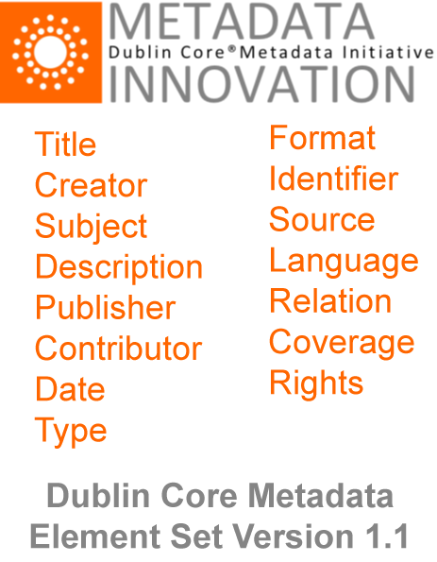
What is Dublin Core?
Dublin Core is a set of metadata designed to describe web content, related to semantic web initiative
Originating in 1995, since mid 2000s DCMI have worked with W3C on Semantic Web efforts
DITA-OT uses a subset of Simple Dublin Core v1.1 when outputting to XHTML
Notes:
Named after Dublin, Ohio btw ;)
“W3C” – “World Wide Web Consortium”

Slide 3
DITA, DITA-OT and Dublin Core
DITA Element(s) | Dublin Core Equivalent
author (topic), authorinformation (map) | Creator
category | Coverage
[output type: XHTML] | Format
critdates | Date
[id value associated with topic type] | Identifier
publisher (topic), publisherinformation (map) | Publisher
copyright | Rights
source | Source
keyword | Subject
title | Title
[topic type] | Type
Notes:
Am not aware of this info previously made available in this compact format

Slide 4
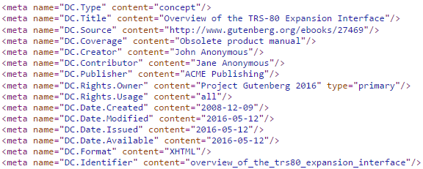
DITA to Dublin Core
DITA topic
Equivalent XHTML output
Notes:
The DITA example is designed to output as many possible Dublin Core metatags (and variants) as possible

Slide 5
Google and Dublin Core
While Dublin Core is long-established, and the DITA-OT supports it, Google does not appear to do much with this content
It can be advantageous from a content management perspective
For example, info on when a topic is created and by whom may be useful to know
Local webserver may be able to filter content or provide faceted search options based on DC values
+
=

