Slide 1
SYCL 2020 and the future
Michael WOng
Acknowledgements: SYCL WG Rod Burns

Slide 2
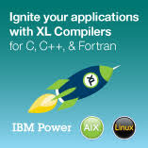
SYCL Single Source C++ Parallel Programming
One-MKL
One-DNN
OneDPC
SYCL-BLAS
SYCL-Eigen SYCL-DNN SYCL Parallel STL
...
Complex ML frameworks can be directly compiled and accelerated
C++ Libraries
Standard C++ Application Code
ML Frameworks
C++ Template Libraries
C++ Template Libraries
C++ Template Libraries
C++ templates and lambda functions separate host & accelerated device code
C++ Kernel Fusion can give better performance on complex apps and libs than hand-coding
SYCL Compiler
CPU Compiler
CPU
Other Backends
Accelerated code passed into device OpenCL compilers
SYCL is ideal for accelerating larger C++-based engines and applications with performance portability
CPU
CPU
GPU
CPU
GPU
CPU
CPU
GPU
CPU
GPU
FPGA
DSP
FPGA
DSP
AI/Tensor HW
AI/Tensor HW
Custom Hardware
Custom Hardware
Notes:
It is a single source C++ parallel programming language that tkes standard ISO C++ application code, even tensorflow, and compiles them with a host CPU compiler, and a device SYCL compiler which generates code for many kinds of devices.

Slide 3
SYCL 2020 is here!
Open Standard for Single Source C++ Parallel Heterogeneous Programming
SYCL 2020 is released after 3 years of intense work
Significant adoption in Embedded, Desktop and HPC markets
Improved programmability, smaller code size, faster performance
Based on C++17, backwards compatible with SYCL 1.2.1
Simplify porting of standard C++ applications to SYCL
Closer alignment and integration with ISO C++
Multiple Backend acceleration and API independent
SYCL 2020 increases expressiveness and simplicity for modern C++ heterogeneous programming
Notes:
First let me talk about something I am really passionate about as char of the SYCL working group.
SYCL2020 is here and it’s ready for developers to use.
SYCL 2020 is released after 3 years of intense work
Significant adoption in Embedded, Desktop and HPC markets
Improved programmability, smaller code size, faster performance
Based on C++17, backwards compatible with SYCL 1.2.1
Simplify porting of standard C++ applications to SYCL
Closer alignment and integration with ISO C++
MultipleBackend acceleration and API independent
SYCL 2020 has increased expressiveness and simplicity for modern C++ hetereogeneous programming.
What’s more, the features of SYCL 2020 have been implemented across multiple SYCL implementations and can be used on real hardware.

Slide 4
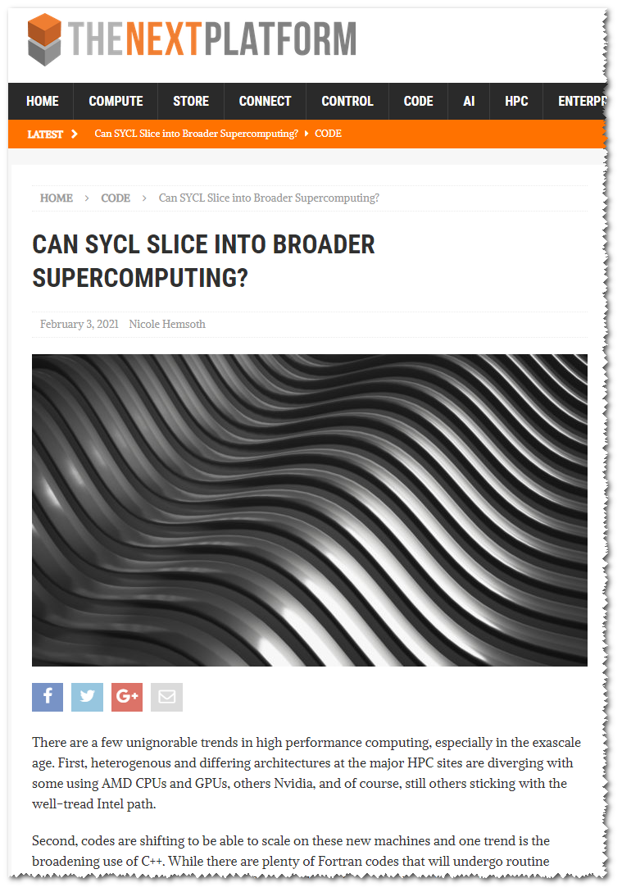
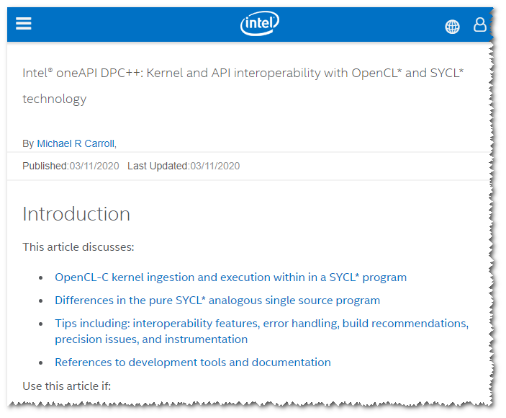
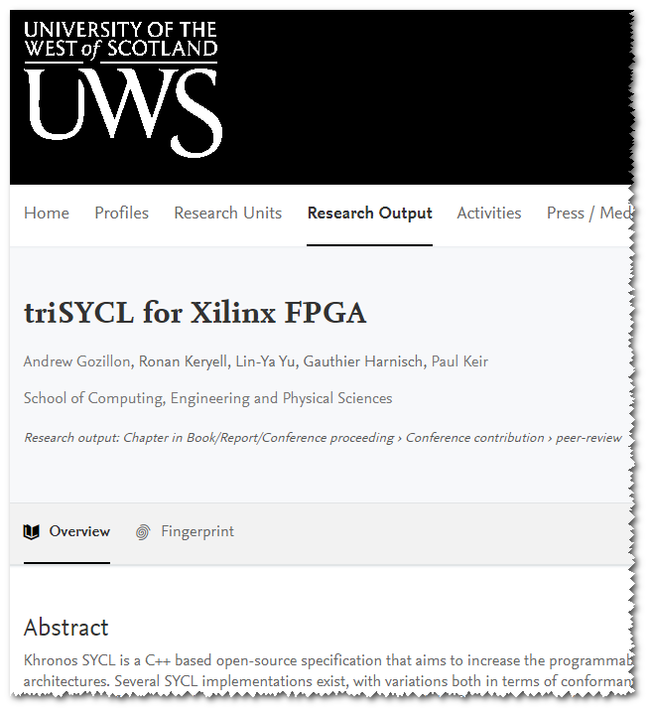
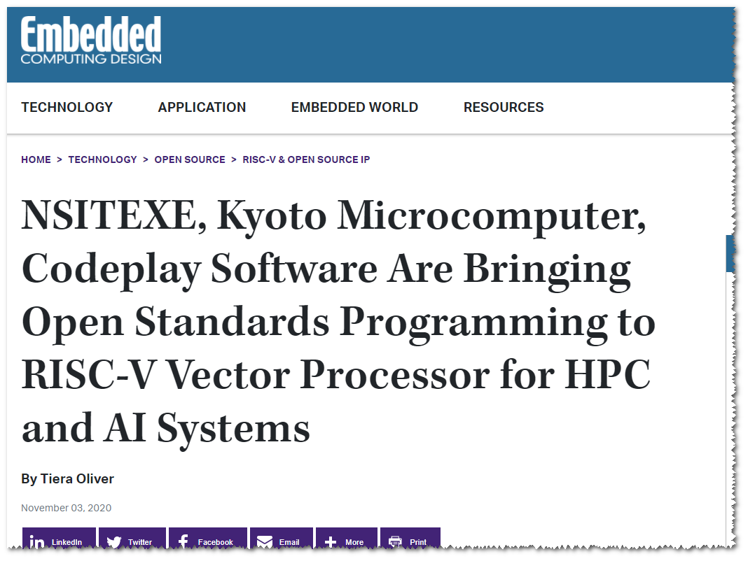
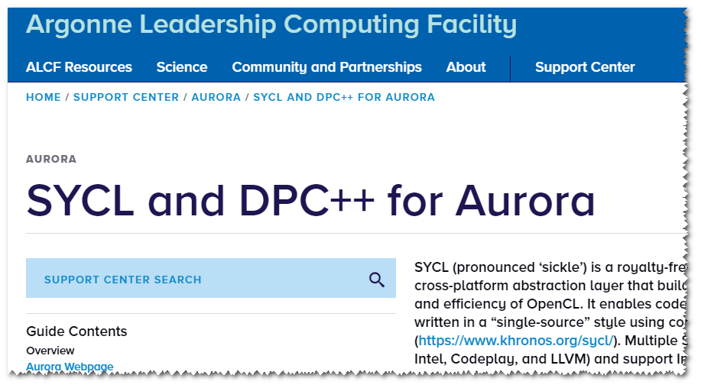
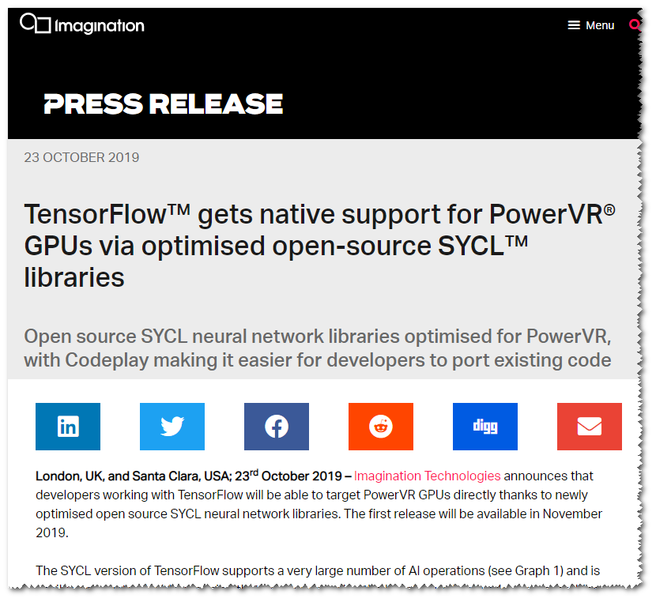
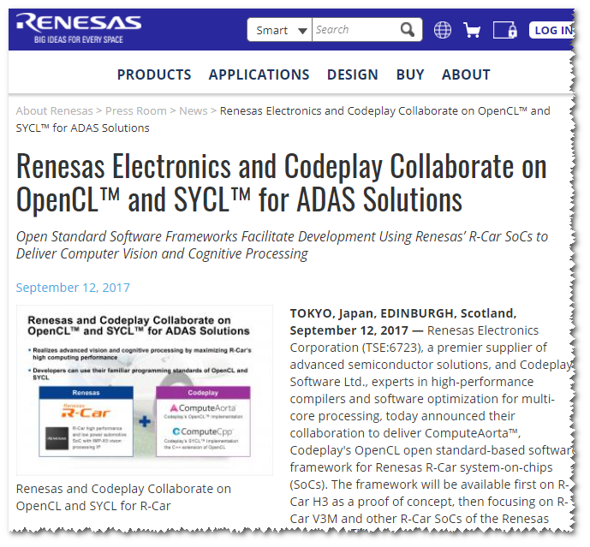
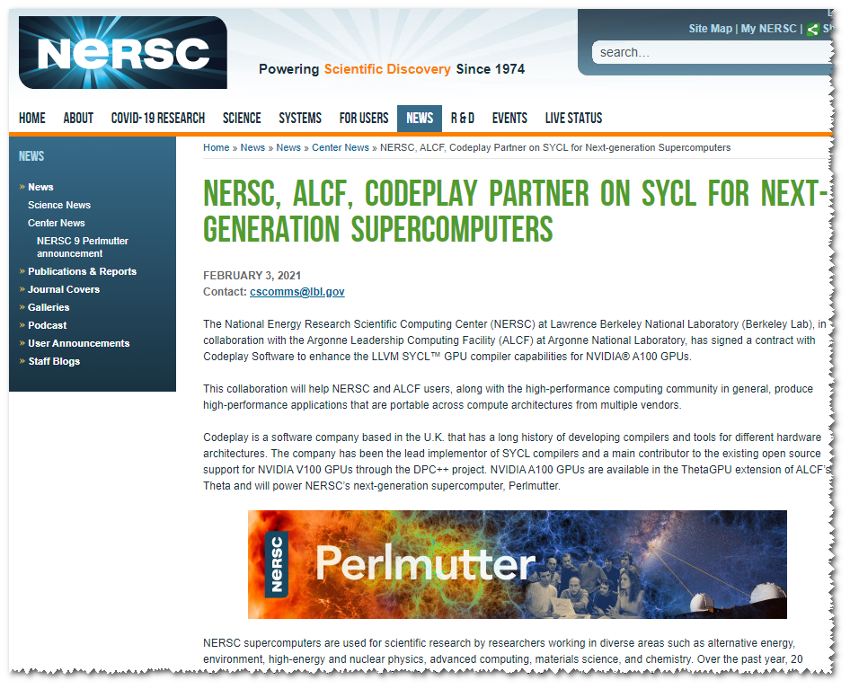
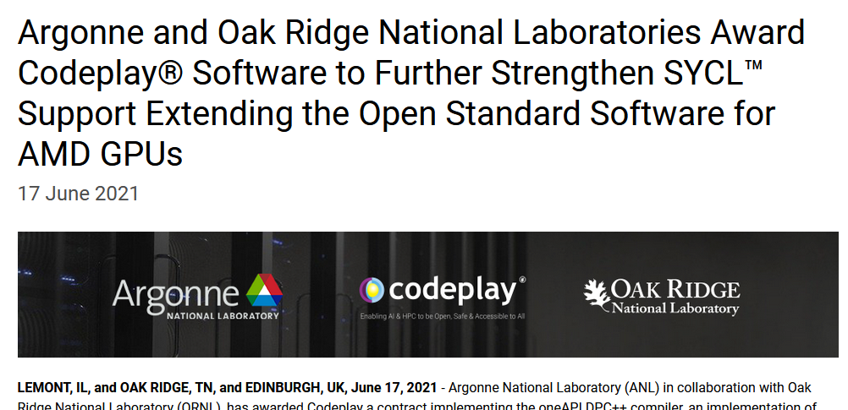
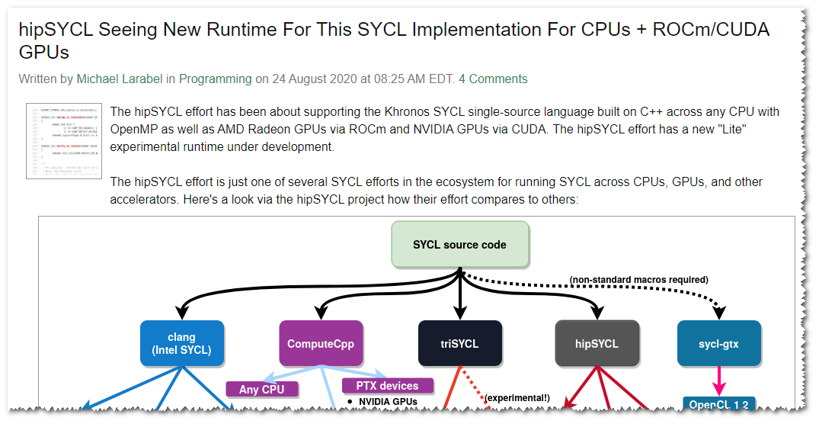
SYCL 2020 Industry Momentum
SYCL support growing from Embedded Systems through Desktops to Supercomputers
https://www.alcf.anl.gov/support-center/aurora/sycl-and-dpc-aurora
https://www.embeddedcomputing.com/technology/open-source/risc-v-open-source-ip/nsitexe-kyoto-microcomputer-and-codeplay-software-are-bringing-open-standards-programming-to-risc-v-vector-processor-for-hpc-and-ai-systems
https://www.nextplatform.com/2021/02/03/can-sycl-slice-into-broader-supercomputing/
https://www.phoronix.com/scan.php?page=news_item&px=hipSYCL-New-Lite-Runtime
https://software.intel.com/content/www/us/en/develop/articles/interoperability-dpcpp-sycl-opencl.html
https://www.renesas.com/br/en/about/press-room/renesas-electronics-and-codeplay-collaborate-opencl-and-sycl-adas-solutions
https://www.nersc.gov/news-publications/nersc-news/nersc-center-news/2021/nersc-alcf-codeplay-partner-on-sycl-for-next-generation-supercomputers/
https://research-portal.uws.ac.uk/en/publications/trisycl-for-xilinx-fpga
https://www.imaginationtech.com/news/press-release/tensorflow-gets-native-support-for-powervr-gpus-via-optimised-open-source-sycl-libraries/
Notes:
I want to point out the incredible SYCL industry momentum in recent years
Most recently, you might have seen the Next platform asking can SYCL slice into SC, and that is based on the announcement of the collaboration with NERSC, Argonne Leadership COmputing Facility on SYCL on the Perlmutter SC. Before that is SYCL and DPC++ on Aurora. DPC++ is the Intel oneAPI implementation of SYCL you see on the top right
There is the NSITEXE Kyoto Miscrocomputer joint work using SYCL on the RISC-V Vector system, there is triSYCL for Xilinx FPGA work from U West Scotland
There is the Renasas Codeplay Collaboration using SYCL and OpenCL on their R-CAR ADAS solutions
There is the hipSYCL implementation for AMD Rocm/CUDa GPUS
There is the tensorflow native support on powerVR using opeimized SYCL libraries

Slide 5
SYCL 2020 Major Features
Unified Shared Memory (USM)
Code with pointers can work naturally without buffers or accessors
Simplifies porting from most code (e.g. CUDA, C++)
Parallel Reductions
Added built-in reduction operation to avoid boilerplate code and achieve maximum performance on hardware with built-in reduction operation acceleration.
Work group and subgroup algorithms
Efficient parallel operations between work items
Class template argument deduction (CTAD) and template deduction guides
Simplified class template instantiation
Simplified use of Accessors with a built-in reduction operation
Reduces boilerplate code and streamlines the use of C++ software design patterns
Expanded interoperability
Efficient acceleration by diverse backend acceleration APIs
SYCL atomic operations are now more closely aligned to standard C++ atomics
Enhances parallel programming freedom
Notes:
What is SYCL 2020?
SYCL 2020 is the newest release of the SYCL specification, ratified by the Working Group in late 2020, published by the Khronos Group in early 2021. It follows SYCL 1.2.1, the last version to be based directly on OpenCL. Previous release followed OpenCL base release and In light of the move to a more generalized backend model as well as following ISO C++’s release based on the year, the project has adopted a year-based versioning scheme.
Most of these features have been implemented in at least one, though many have been in all of them
SYCL 2020 represents a major step forward, featuring over 40 new additions and improvements, including:
Unified Shared Memory (for pointer-based programming convenience) all
Parallel Reductions
Work-group and sub-group algorithms
Improvements to atomic operations
Class template argument deduction (CTAD) and deduction guides all
Simplification of accessors - all
Expanded interoperability with different backends - all

Slide 6
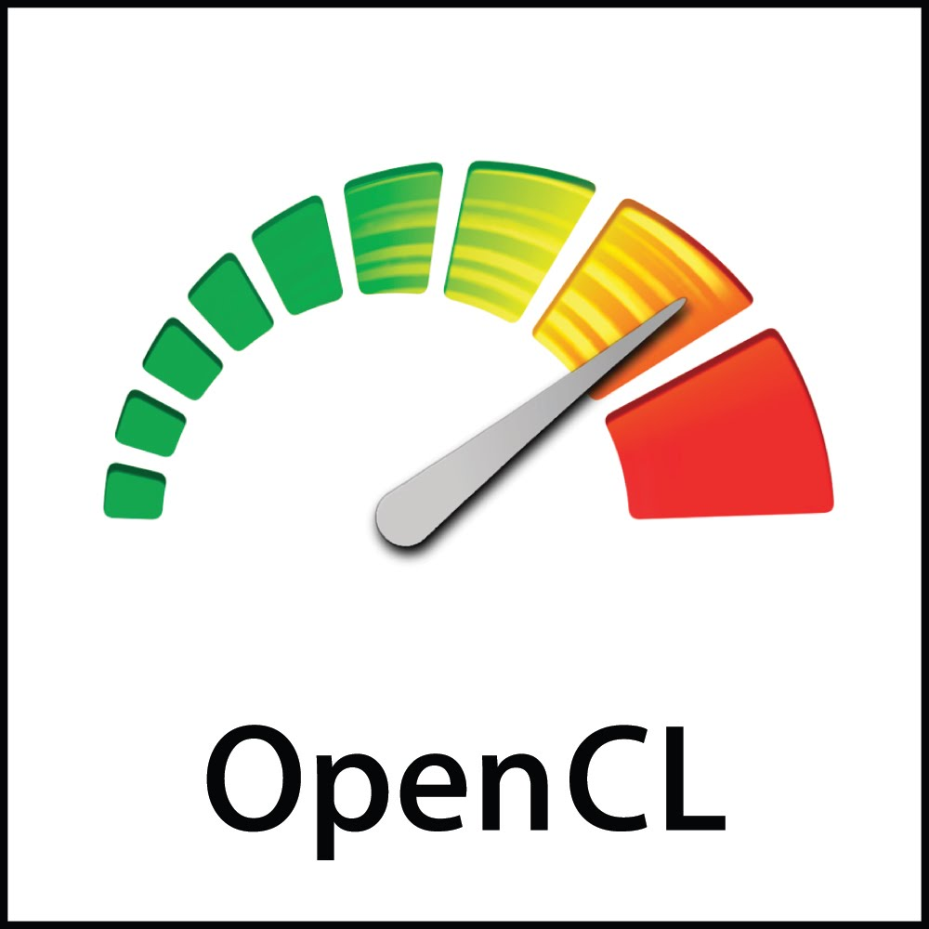
Parallel Industry Initiatives
C++11
C++14
C++17
C++20
C++23
SYCL 1.2
C++11 Single source programming
SYCL 1.2.1
C++11 Single source programming
SYCL 2020
C++17 Single source programming
Many backend options
SYCL 202X
C++20 Single source programming
Many backend options
OpenCL 1.2
OpenCL C Kernel Language
OpenCL 2.1 SPIR-V in Core
OpenCL 2.2
OpenCL 3.0
2011
2015
2017
2020
202X
Notes:
this slide is about parallel industry initiatives and the possible future roadmap of SYCL, where we released SYCL2020 based on C++17. This means it enables exciting C++ features such as CTAD and Deduction guides that makes code less verbose. There are also a number of other great features which I will highlight.
You will also see that we released SYCL 1.2.1 in 2017, and previously 1.2 in 2015. And if you were to predict that we seem to be settling down to a cadence of releasing new releases every 1.5-3 years, matching to the ISO C++ schedule, you will be correct. This is because we have adapted to a bus-train model of delivery. You will also see that we have changed the naming scheme from aligning with OpenCL version to naming by year to allow us to be based on multiple backend options in addition to OpenCL, which remains our primary backend.
You will also see that we are projecting, tentatively, that a future SYCL will be released after 2021 (exact version to be named later) and will likely be based on C++20 which will be released at the end of this year.
This shows our tighter ISO C++ alignment injecting our heterogeneous knowledge into ISO and adapting C++ features.
Today I am unveiling this slide about the possible future roadmap of SYCL, where in 2020 we released first a provisional in Q2 for public review and feedback leading to a final in Q4. We plan this version to be based on C++17. This means it enables exciting C++ features such as CTAD and Deduction guides that makes code less verbose. There are also a number of other great features which I will highlight.
You will also see that we released SYCL 1.2.1 in 2017, and previously 1.2 in 2015. And if you were to predict that we seem to be settling down to a cadence of releasing new releases every 1.5-3 years, matching to the ISO C++ schedule, you will be correct. This is because we have adapted to a bus-train model of delivery. You will also see that we have changed the naming scheme from aligning with OpenCL version to naming by year to allow us to be based on multiple backend options in addition to OpenCL, which remains our primary backend.
You will also see that we are projecting, tentatively, that a future SYCL will be released after 2021 (exact version to be named later) and will likely be based on C++20 which will be released at the end of this year.
This shows our tighter ISO C++ alignment injecting our heterogeneous knowledge into ISO and adapting C++ features.
Next Slide, please..

Slide 7
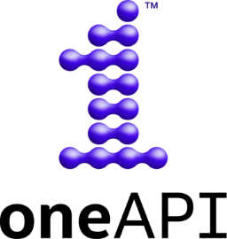
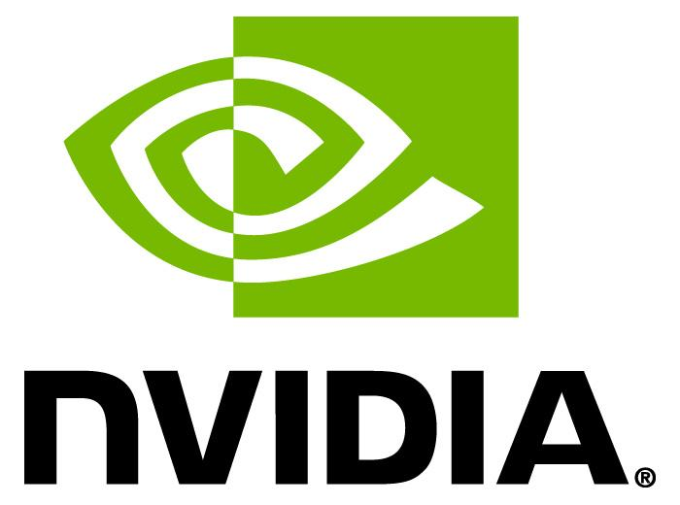
SYCL Implementations in Development
SYCL, OpenCL and SPIR-V, as open industry standards, enable flexible integration and deployment of multiple acceleration technologies
Source Code
SYCL enables Khronos to influence ISO C++ to (eventually) support heterogeneous compute
DPC++
Uses LLVM/Clang
Part of oneAPI
ComputeCpp
Multiple Backends
triSYCL
Open source
test bed
hipSYCL
CUDA and HIP/ROCm
neoSYCL
SX-AURORA TSUBASA
neoSYCL
SX-AURORA TSUBASA
Experimental
Any CPU
Any CPU
NVIDIA
GPUs
Any CPU
Experimental
Any CPU
NVIDIA GPUs
NVIDIA GPUs
TBB
Any CPU
VEO
VEO
Intel CPUs
NEC VEs
Intel CPUs
Intel GPUs
Intel FPGAs AMD GPUs (depends on driver stack)
Arm Mali
IMG PowerVR
Renesas R-Car
Level Zero
Kunpeng
Ascend
Shengteng
Level Zero
XILINX FPGAs
POCL (open-source OpenCL supporting CPUs and NVIDIA GPUs and more)
AMD GPUs
Intel GPUs
Intel GPUs
Multiple Backends in Development
There is development on supporting SYCL on even more low-level frameworks. For more information: http://sycl.tech
Intel CPUs
Intel GPUs
Intel FPGAs
Notes:
Note (Peter): I’ve duplicated the slide to propose some changes

Slide 8
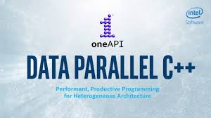
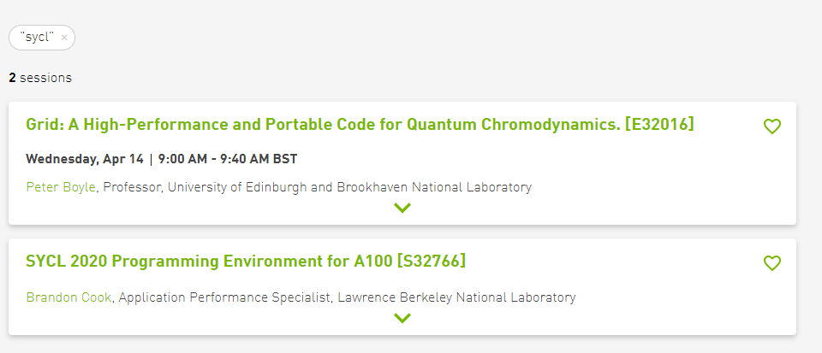
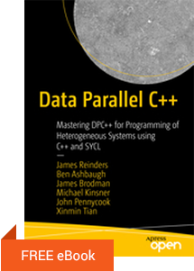
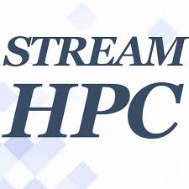
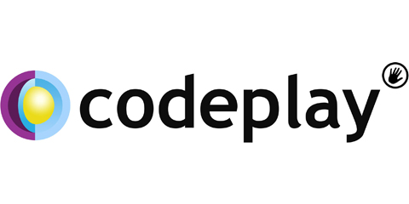
SYCL Ecosystem, Research and Benchmarks
Implementations
Research
Direct Programming Benchmark
Linear Algebra Libraries
Machine Learning Libraries and Parallel Acceleration Frameworks
Benchmarks/Books
triSYCL
BLAS | FFT | Math | RAND
SYCLBLAS oneMKL | oneMKL | oneMKL | oneMKL
SOLVER | SPARSE | TENSOR | STL
oneMKL | oneMKL | SYCL-DNN Eigen oneDNN | SYCL Parallel STL oneDPL
neoSYCL
SX-AURORA TSUBASA
SYCL-Bench
360k downloads
Working Group Members
Notes:
This highlights the already large and growing SYCL ecosystem. Starting with the implementations on the left including the new NeoSYCL, then there are the many research papers. Of this I have talked about the Exascale Computing Project and Celerity for SYCL cluster last year.
These projects allows SYCL to run on Exascale and petascale supercomputer systems.
Kokkos and Raja C++ are Performance Portability Programming frameworks for C++ Parallel Execution and Memory Abstraction
One of our WG member, Nevin Liber is working on delivering SYCL on Kokkos.
Gromacs is A molecular dynamics package mainly designed for simulations of proteins, lipids, and nucleic acids from Stockholm University, that is also a SPEC CPU benchmark and is now being acceelrated for SYCL
The alpaka library is a header-only C++14 abstraction library for accelerator development from HZDR, LBNL
TaskFlow is A General-purpose Parallel and Heterogeneous Task Programming System extending for task graph parallelism for distributed and heterogeneous nodes from University of Utah’s Professor Huang.
The ATLAS Experiment Athena is a high energy physics experiment looking for higg’s Boson and quarks from CERN
And recently, we had 2 talks in GTC 2021 by Brandon Cook, LBNL/NERSC, and Peter Boyle of U of Edinburgh.
Next column are benchmarks and Books.
We have Direct Programming Benchmark which is a collection of data-parallel programs for evaluating oneAPI direct programming. Each program is written with CUDA, SYCL, and OpenMP-4.5 target offloading.
We have SYCL Bench Suite which is a Versatile Cross-Platform Benchmark Suite for Heterogeneous Computing
From University of Salerno, University of Heidelberg, University of Innsbruck
We also now have a oneAPI SYCL book published by James reindeer, whom you will hear or heard in a Keynote, with members of Intel’s team, all have been good friends that I have worked with, some for decades.
There are also many libraries for Linear Algebra, Machine Learning and Parallel Acceleration Frameworks now separated into what domain they serve, including BLAS, FFT, Math, Random, Solver, Sparse matrix, tensor, and STL
At the bottom you will see the working group companies attending the weekly calls 1-2 times a week.
Next Slide, please.

Slide 9
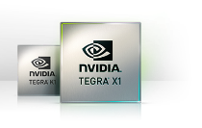
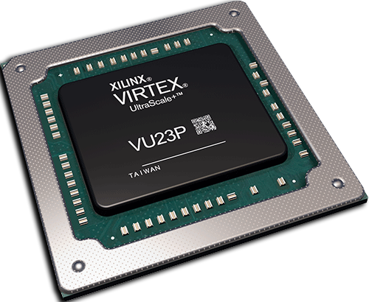
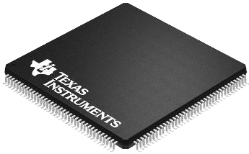
SYCL in Embedded Systems, Automotive, and AI
Networks trained on high-end desktop and cloud systems
Neural Network Training
Training Data
Open industry standards, enable flexible integration and deployment of multiple acceleration technologies
Trained Networks
Compilation
Ingestion
Applications link to compiled inferencing code or call vision/inferencing API
Compiled
Code
Vision / Inferencing
Engine
C++ Application Code
Hardware Acceleration APIs
Sensor Data
Diverse Embedded Hardware Multi-core CPUs, GPUs DSPs, FPGAs, Tensor Cores
* Vulkan only runs on GPUs
DSP
Dedicated Hardware
GPU
FPGA
Notes:
5. Here we see how Khronos standards can be used in a typical mobile or embedded application needing vision or inferencing acceleration. Neural network training typically occurs on high-powered desktops or servers at high precision, using large training data sets. The resulting trained network, encapsulated in an NNEF/onnx file, can be imported into the target system in two ways: either ingested into an inferencing engine such as OpenVX, or passed into a machine learning compiler to generate code that executes inferencing operations. Either the compiled code or the inferencing engine API is linked into the application, which may also use the SYCL compiler to generate additional parallel code if the application is written in C++. Code generated by all these methods can target the lower level OpenCL API to portably reach into diverse hardware processors.

Slide 10
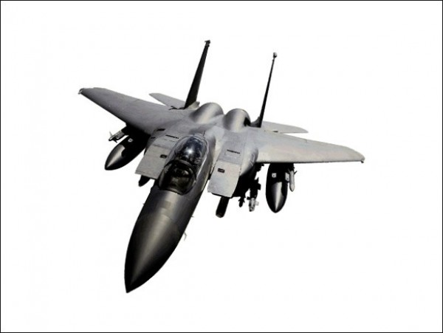
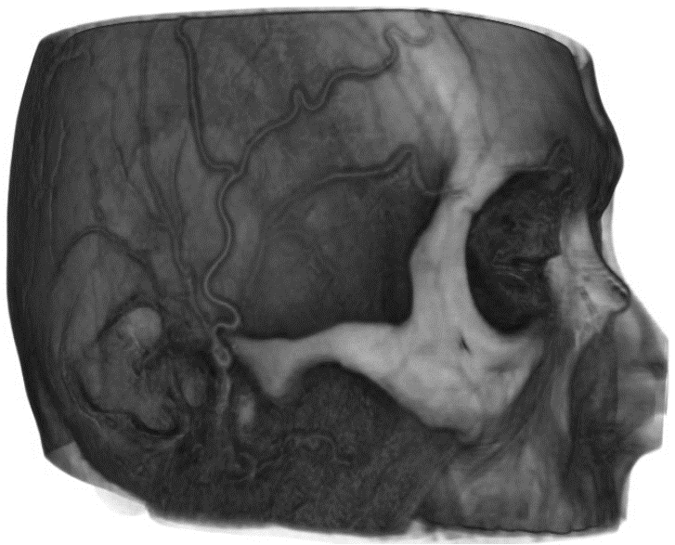
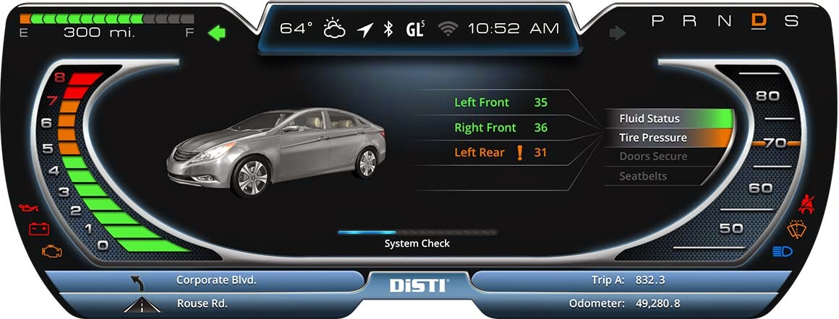
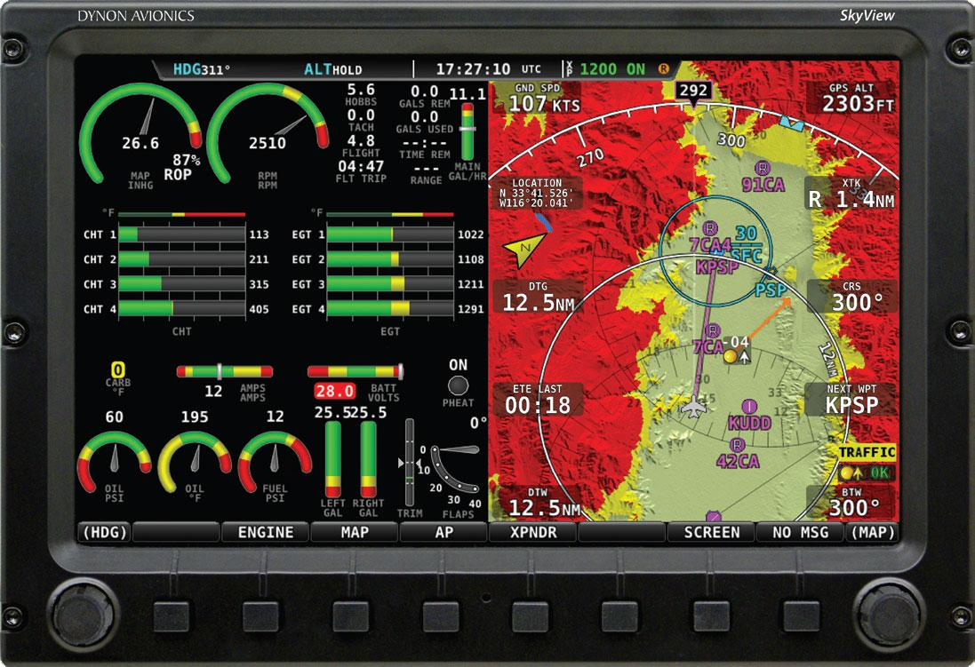
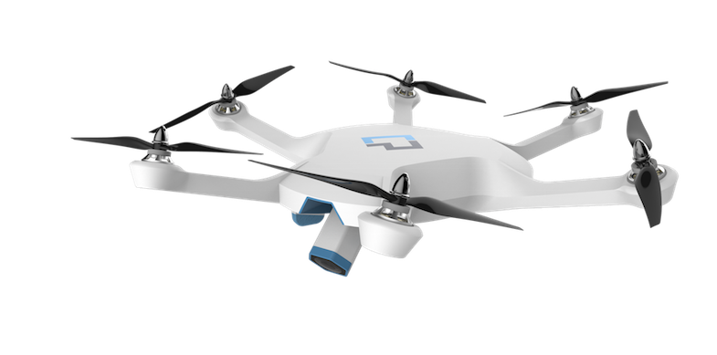
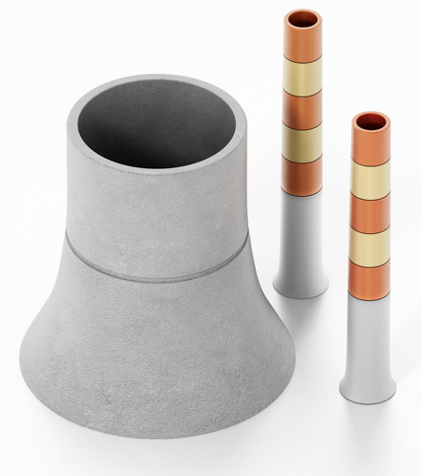
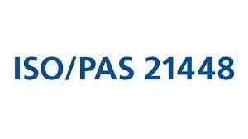
Safety Critical API Evolution
New Generation Safety Critical APIs for Graphics, Compute and Display
OpenCL and SYCL SC work will minimize API surface area , reduce ambiguity, UB, increase determinism
Rendering
Compute
Display
Industry Need for GPU Acceleration APIs designed to ease system safety certification is increasing
ISO 26262 / ASIL-D
Notes:
We are also going all in on Safety Critical, ethics, functional safety, AI/ML Safety. SYCL, like OpenCL aims to serve the embedded/automotive/AI domain with Safety Critical in the future just like other current United Nations Economic Commission for Europe UNECE wp29, Khrons API by being part of RISC V,MISRA, ISO SC42 on AI/ML trustworthiness/ethics,safety of ML, ISO 26226, 21448 functional Safety and Safety of the intended functionality, Safety Critical systems club
,UL4600, SAE ORAD, This is one of the talk this week outlining an initial proposal on Automotive ADAS safety built on a tower of overlapping safety layers from teh application, to the library, on top of SYCL, over a HW abstraction layer or BE down to the HW driver.

Slide 11
SYCL in HPC/Supercomputers
Simulation
HPC Languages Solver Libraries, Parallel RT
Data
Productivity Languages
Big Data Stack, Stats Lib, Databases
Learning
Productivity Languages Deep Learning, Linear Alg, ML
Three Pillars of Science Problem
Today’s Supercomputing Development Workflow needs knowledge of system architecture and tools that control data
Need Languages that allow control of these Data Issues
Set Data affinity, Data Layout, Data movement, Data Locality, highly Parameterized Code and dynamically compose the algorithms (C++ templates, parallel STL, inlining and fusion, abstractions)
OpenMP for C and Fortran
CUDA/pthreads/ OpenACC/OpenCL
C++ Application uses SYCL, Kokkos, Raja
Choose Algorithm for target
Math, ML, Data Libraries; C++ Std, C, Python Libraries
Libraries augment compiler optimizations for Performance Portable programs
Implement and Test Algorithm
2021
2021
2022
2022
2023
Use open standards to run Performance Portable code on new generation, or different vendor’s, hardware with compiler optimization, explicit parametrization and dynamically composed algorithm
Optimize Algorithm
Notes:
HPC workload persists for 20 years while HW can change every 5, often to different vendors. They need to serve the three pillars of Science problems:
Simulation which needs an HPC language with solvers and parallel RT,
Data Science which needs a High productivity language for big Data
Learning (training/inference) needs a High productivity language for ML
These have been supported by the top 3 set of languages: OpenMP mostly for C/Fortran, a mix of CUDA/OpenACC/OpenCl, and now for C++ SYCL, Kokkos, Raja.
The Development workflow for these science problems starts with
1. choosing an algorithm, unlike before, today that choice needs feedback knowledge of the system architecture and tools and those tools need to have control of the data layout, movement, locality and affinity or they will be non-performant; SYCL and other C++ frameworks enables these parameterization and dynamically configured algorithm through C++ capabilities like templates and inlining
2. Implement and test the algo
3. Optimize the algo, traditionally this was the only step that needed architecture and tool knowledge
All these steps enable to reach performance portable code.
They are required to reach Exascale computing for the 4 major systems of which 2 are now using SYCL: ANL’s Aurora, and NERSC/LBNL’s Perlmutter
The other 2 are AMD systems Frontier and El Capitan and SYCL has demonstrated to work on AMD systems as well. This parametrization and dynamically composed algorithm along with compiler optimization using an Open Standard programming model is what we think will enable performance portability.

Slide 12
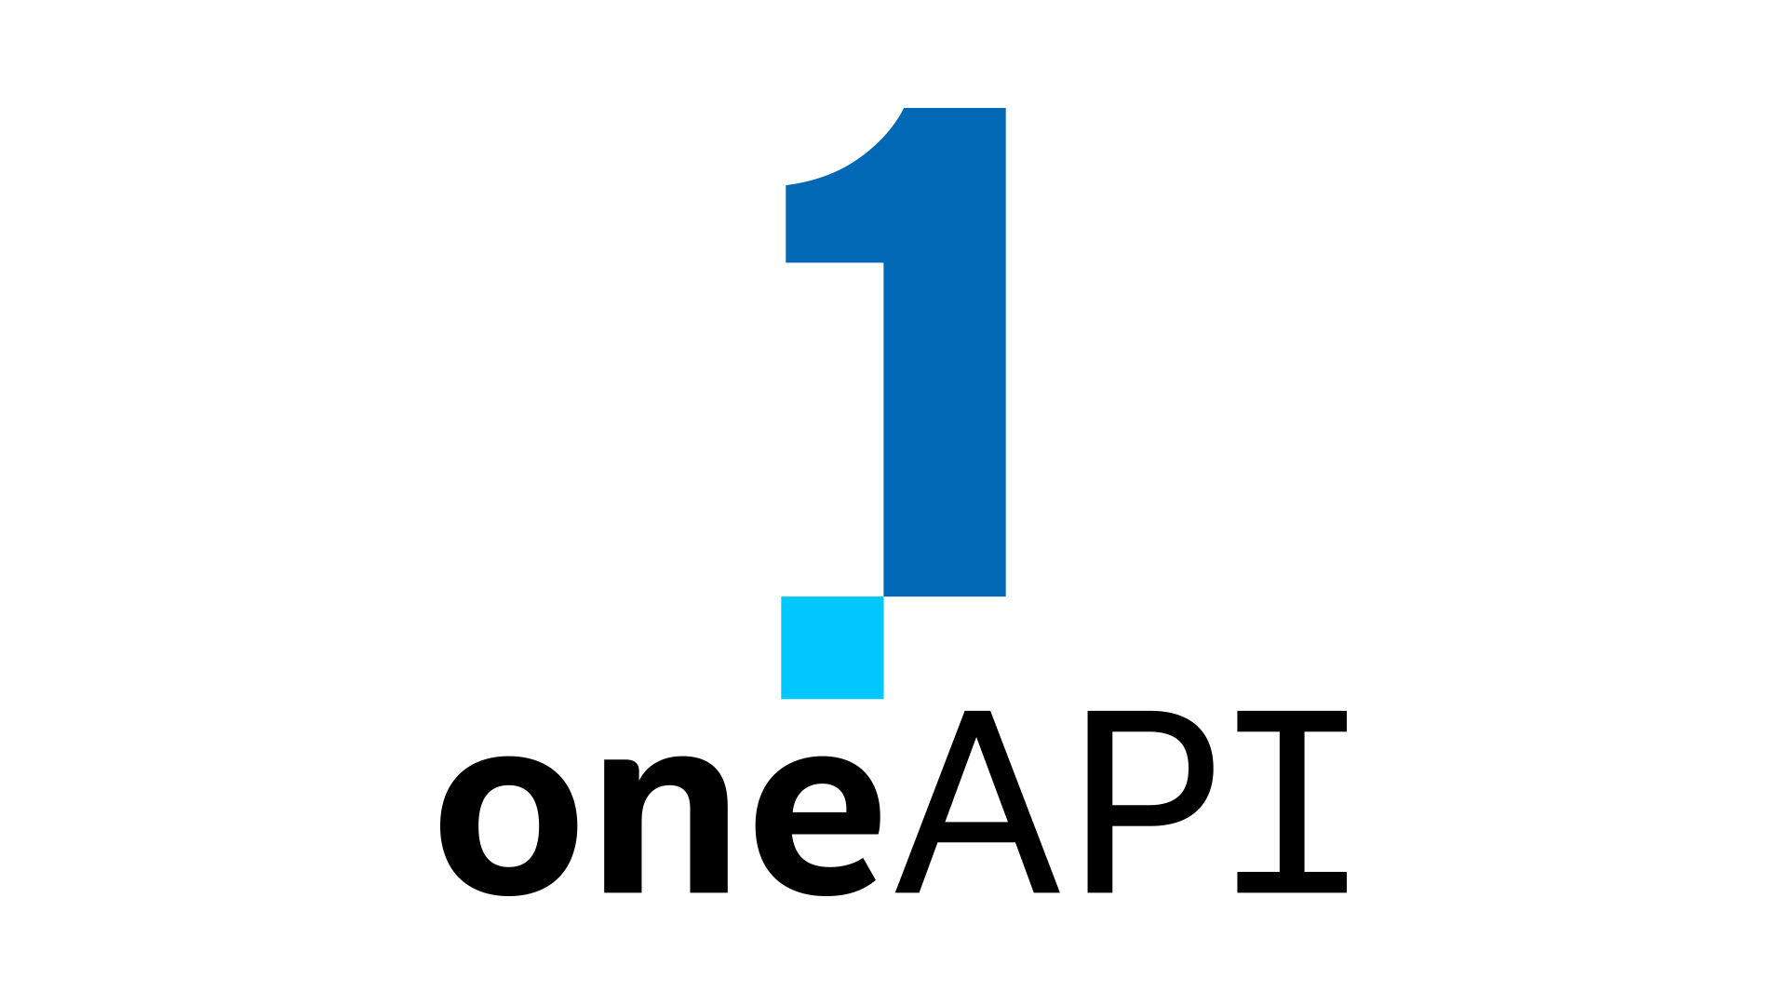
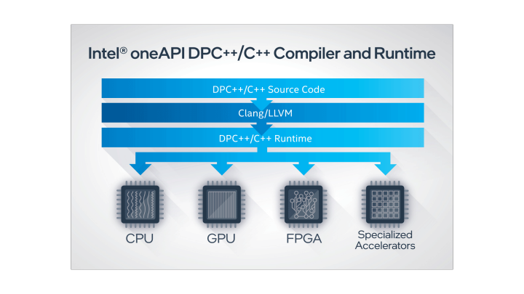
oneAPI and SYCL
SYCL sits at the heart of oneAPI
Provides an open standard interface for developers
Defined by the industry
SYCL source code
Notes:
Finally I will start by talking about how oneAPI and SYCL are working together to bring developers an open standard environment for developers. oneAPI provides developers with a platform to build accelerated software, and SYCL sits at the heart of oneAPI, providing a mature, open standard interface for developers. When you write code using the oneAPI platform, you will be using the SYCL interface to interact with the low level hardware on your machine, whether that is targeting Intel GPUs, Nvidia GPUs or AMD GPUs. The DPC++ compiler is an implementation of the SYCL standard, and makes targeting massively parallel hardware architectures simple, and provides you with portability across different targets. The SYCL standard is defined by the whole industry, with myself as the chair, members from many major processor vendors, national laboratories and research groups ensuring that the standard continues to meet the needs of companies making processors and the software developers who want to easily target these processors.

Slide 13
Nvidia and AMD Support in oneAPI
Extending DPC++ to target Nvidia and AMD GPUs
Supporting Perlmutter, Polaris and Frontier supercomputers
Open source and available to everyone
Different targets using a simple compiler flag
SYCL source code
clang++ -fsycl -fsycl-targets=nvptx64-nvidia-cuda
clang++ -fsycl -fsycl-targets=amdgcn-amd-amdhsa
https://www.codeplay.com/oneapiforcuda
Resources for AMD coming soon
Notes:
Codeplay has been involved in defining the SYCL standard since the beginning, and we have spent many years implementing our own compiler ComputeCpp which has been focused on delivering SYCL support to customers. We are also closely involved in working on the oneAPI initiative, and have been implementing support for multiple processor architectures for DPC++ and some oneAPI libraries. Currently we are adding support for all the features of SYCL on the Perlmutter pre-exascale supercomputer and continue to extend this to things like tensor cores. We are also working to extend support in DPC++ for the Frontier exascale supercomputer being built for Oak Ridge National Laboratory, this work is in a development state but we expect this to be ready for developers to use very soon. You can find instructions to set up DPC++ for CUDA support on this web url and AMD information will come soon. The compilation step can’t be simpler, change the target flag to tell the compiler to make binaries for the Nvidia CUDA target as shown in the command on this slide.

Slide 14
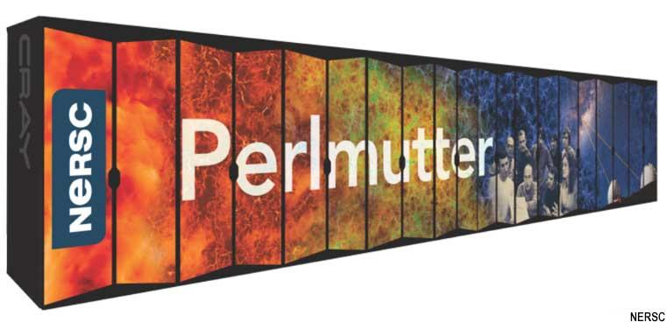
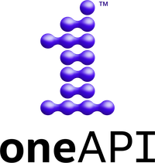
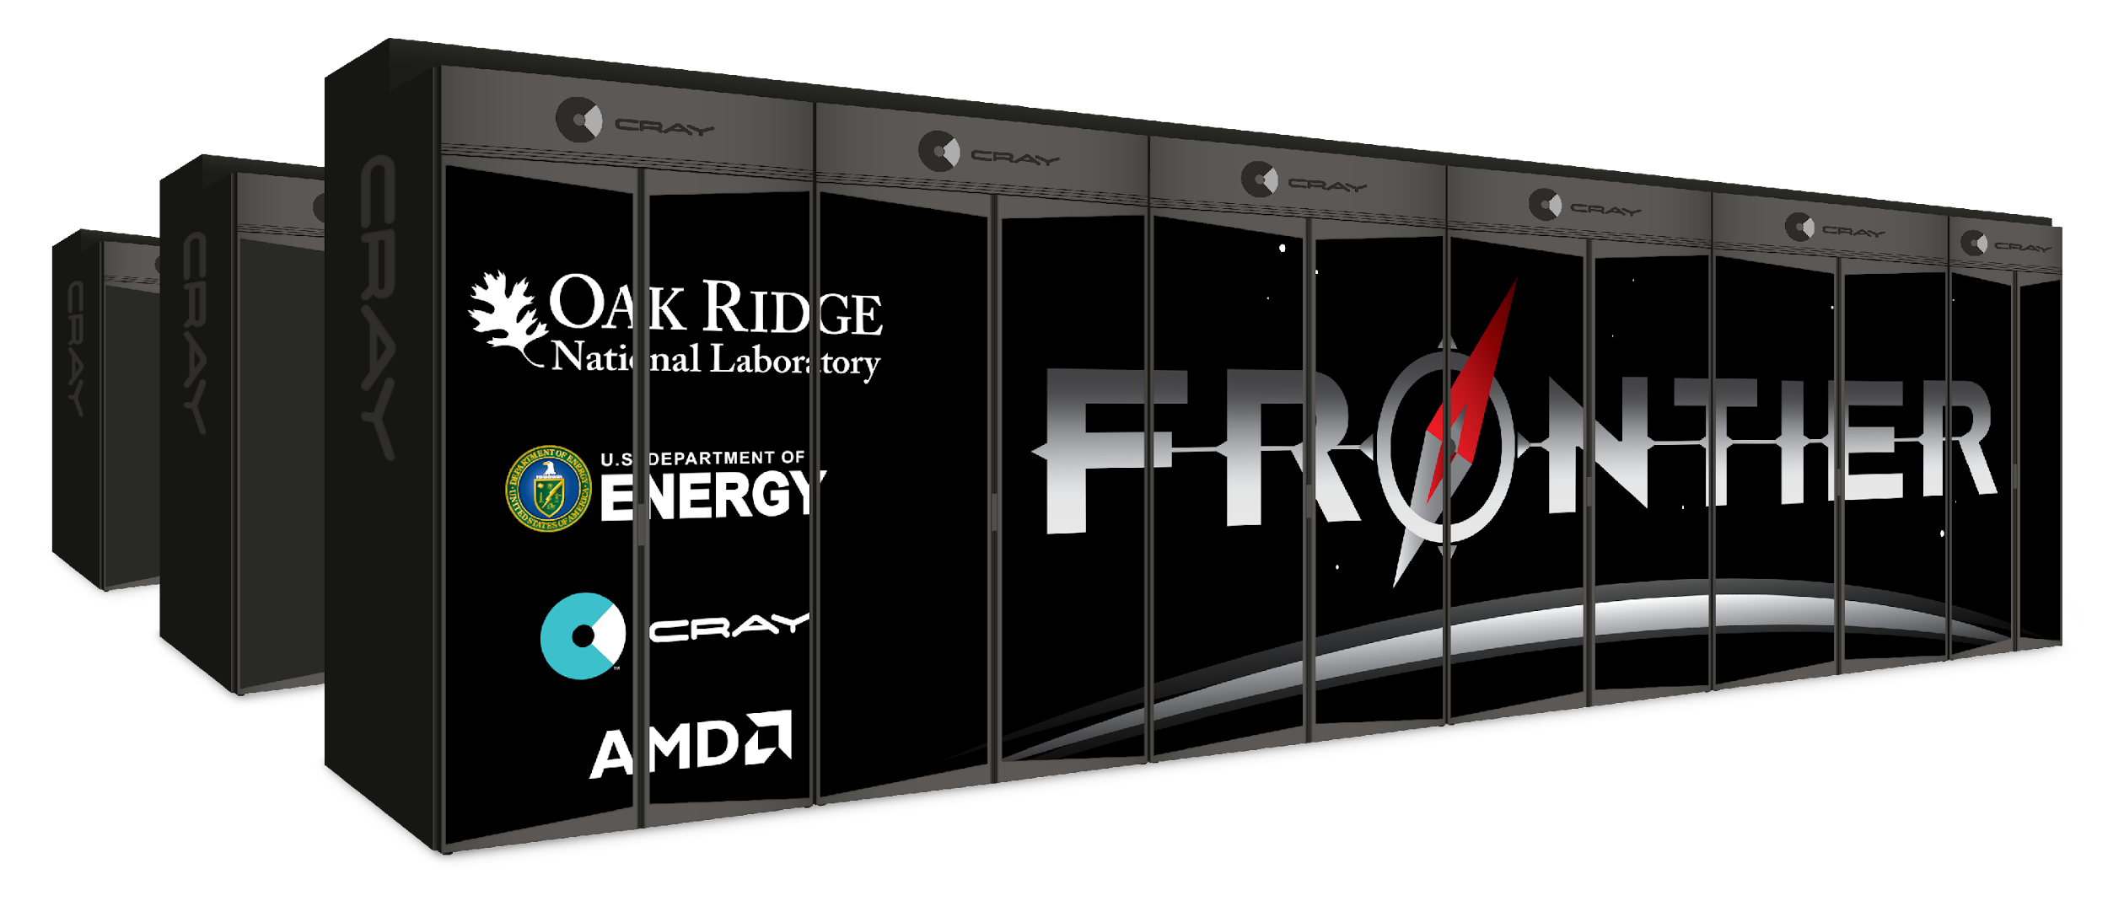
SYCL Enables Supercomputers
“this work supports the productivity of scientific application developers and users through performance portability of applications between Aurora and Perlmutter.”
Enables a broad range of software frameworks and applications
Intel GPUs
NVIDIA GPUs
Codeplay works in partnership with US National Laboratories to enable SYCL on exascale supercomputers
AMD GPUs
Notes:
The strategy of the National Laboratories in the United States is focused on enabling developers with a standard programming environment so that the software they write can be deployed across multiple supercomputers that bring pre-exascale to exascale computing to researchers. Codeplay has built partnerships with Lawrence Berkeley National Laboratory, Argonne National Laboratory and Oak Ridge National Laboratory to enable SYCL on their next generation of supercomputers using the DPC++ open source compiler project. You can see a small snapshot of some of the frameworks and software that is enabled by using the SYCL open standard, from LAMMPS, a particle simulator, to Eigen, a linear algebra library used by the TensorFlow framework for tensor operations.

Slide 15
SYCL Future Evolution
SYCL 2020 compared with SYCL 1.2.1
Easier to integrate with C++17 (CTAD, Deduction Guides...)
Less verbose, smaller code size, simplify patterns
Backend independent
Multiple object archives aka modules simplify interoperability
Ease porting C++ applications to SYCL
Enable capabilities to improve programmability
Backwards compatible but minor API break based on user feedback
SYCL Future Roadmap (MAY CHANGE)
Integration of successful
Extensions plus new Core functionality
Improving Software Ecosystem
Books, Tutorials, Tool, libraries, GitHub
Expanding Implementations
DPC++
ComputeCpp
triSYCL
hipSYCL
neoSYCL
Regular Maintenance Updates
Spec clarifications, formatting and bug fixes
https://www.khronos.org/registry/SYCL/
NEXT
SYCL 2020
Over 40 Selected Features for SYCL 2020
Unified Shared Memory)
Parallel Reductions adds a built in reduction operation
Work-group and sub-group algorithms
Improvements to atomic operations
Class template argument deduction (CTAD) and deduction guides
Simplification of accessors
Expanded interoperability with different backends
Extension mechanism
Address spaces
Vector rework
Specialization Constants
...
Conformance Tests
Working on Implementations
Future SYCL NEXT Proposals
...
Converge SYCL with ISO C++ and continue to support OpenCL to deploy on more devices
CPU
GPU
FPGA
AI processors
Custom Processors
Repeat The Cycle every 1.5-3 years
Notes:
This is the main slide. It shows what is in SYCL 2020 on the bottom left
you will see some of the 40 features we have.
and in the top box, our general larger philosophy that we have followed in our change from SYCL 1.2.1 and SYCL 2020.
In the bottom right, you will see what we have to do NEXT, in the form of conformance tests, and working on conforming implementations, as well as new SYCL Next feature proposals and on the far right you see that our main goal is converging SYCL and ISO while continuing to strongly support OpenCL, driving to support more kinds of chips.
The main diagram illustrates our philosophy of moving from SYCL 2020 to SYCL NEXT and iterating this cycle with new releases every 1.5-3 years from previous to next release.
Next Slide, please.
We want easier integration with C++17, less verbose language, that has smaller code size, and simplify common patterns. We wish to enable multiple backends, but simplify interoperability while at the same time ease porting of C++ applications to SYCL, improving programmability. We aim to strike a balance for performance and stability by enabling backwards compatibility with previous releases, but also selectively break API to achieve higher performance.. We expect that breakage to be minor from SYCL 1.2.1 to 2020.
Generalization (a.k.a the Backend Model) presented by Gordon Brown
Accidental massive change! but gives us independence from OpenCL, though we still are deeply tied to it
But now can adapt to Vulkan, CUDA, OpenMP... backends
Unified Shared Memory (USM) presented by James Brodman
Enables code with pointers in data structure naturally without translation, buffers or accessors
Help ports from some lower level language, CUDA
Improvement to Program class Modules presented by Gordon Brown
No, not those modules from C++
Embed multiple objects into archives even for different backends!
Reduces ambiguity in spec and removes states
Specialization constants
Specialize values at compile time
Like a JIT, provides compile time feature at runtime
This enables us to compile tensorflow which has hundreds of kernels with slightly different constants without much code bloat
Reductions
Top request from IWOCL/DHPCC++ 2019
Adds a builtin reduction operation, very useful and avoids boiler plate code , leverage hardware operators
Improvement on single-source programming specification
Address space
Better consistent experience between implementations
Host Task with Interop presented by Gordon Brown
Simpler interaction between SYCL task graph and host code
Removed standard layout restrictions
Less restriction on the C++ code we can compile, as trivially copyable is generally good enough
In order queues, presented by James brodman
Similar to CUDA queues, one kernel at a time
When you don’t care about data dependency, or is using USM, or porting CUDA codes

Slide 16
A Demo with C++ Parallel STL

Slide 17
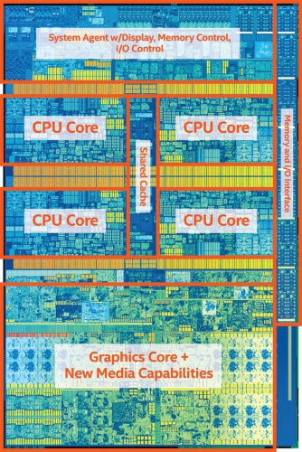
What can I do with a Parallel For Each?
size_t nElems = 1000u;
std::vector<float> nums(nElems);
std::fill_n(std::begin(v1), nElems, 1);
std::for_each(std::begin(v), std::end(v),
[=](float f) { f * f + f });
10000 elems
Traditional for each uses only one core,
rest of the die is unutilized!
Intel Core i7 7th generation

Slide 18
What can I do with a Parallel For Each?
size_t nElems = 1000u;
std::vector<float> nums(nElems);
std::fill_n(std::execution_policy::par,
std::begin(v1), nElems, 1);
std::for_each(std::execution_policy::par,
std::begin(v), std::end(v),
[=](float f) { f * f + f });
2500 elems
2500 elems
2500 elems
2500 elems
Workload is distributed across cores!
(mileage may vary, implementation-specific behaviour)
Intel Core i7 7th generation

Slide 19
What can I do with a Parallel For Each?
size_t nElems = 1000u;
std::vector<float> nums(nElems);
std::fill_n(std::execution_policy::par,
std::begin(v1), nElems, 1);
std::for_each(std::execution_policy::par,
std::begin(v), std::end(v),
[=](float f) { f * f + f });
2500 elems
2500 elems
2500 elems
2500 elems
What about this part?
Workload is distributed across cores!
(mileage may vary, implementation-specific behaviour)
Intel Core i7 7th generation

Slide 20
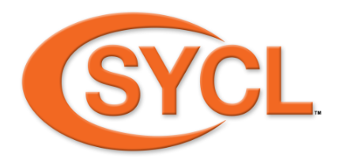
What can I do with a Parallel For Each?
size_t nElems = 1000u;
std::vector<float> nums(nElems);
std::fill_n(sycl_policy,
std::begin(v1), nElems, 1);
std::for_each(sycl_named_policy
<class KernelName>,
std::begin(v), std::end(v),
[=](float f) { f * f + f });
10000 elems
Workload is distributed on the GPU cores
(mileage may vary, implementation-specific behaviour)
Intel Core i7 7th generation

Slide 21
What can I do with a Parallel For Each?
size_t nElems = 1000u;
std::vector<float> nums(nElems);
std::fill_n(sycl_heter_policy(cpu, gpu, 0.5),
std::begin(v1), nElems, 1);
std::for_each(sycl_heter_policy<class kName>
(cpu, gpu, 0.5),
std::begin(v), std::end(v),
[=](float f) { f * f + f });
1250 elems
1250 elems
1250 elems
1250 elems
5000 elems
Experimental!
Workload is distributed on all cores!
(mileage may vary, implementation-specific behaviour)
Intel Core i7 7th generation

Slide 22
Notes:
44:30

Slide 23
Demo Results - Running std::sort
(Running on Intel i7 6600 CPU & Intel HD Graphics 520)
size | 2^16 | 2^17 | 2^18 | 2^19
std::seq | 0.27031s | 0.620068s | 0.669628s | 1.48918s
std::par | 0.259486s | 0.478032s | 0.444422s | 1.83599s
std::unseq | 0.24258s | 0.413909s | 0.456224s | 1.01958s
sycl_execution_policy | 0.273724s | 0.269804s | 0.277747s | 0.399634s

Slide 24
SYCL 2020 is here!
Open Standard for Single Source C++ Parallel Heterogeneous Programming
SYCL 2020 is released after 3 years of intense work
Significant adoption in Embedded, Desktop and HPC markets
Improved programmability, smaller code size, faster performance
Based on C++17, backwards compatible with SYCL 1.2.1
Simplify porting of standard C++ applications to SYCL
Closer alignment and integration with ISO C++
Multiple Backend acceleration and API independent
SYCL 2020 increases expressiveness and simplicity for modern C++ heterogeneous programming
Notes:
First let me talk about something I am really passionate about as char of the SYCL working group.
SYCL2020 is here and it’s ready for developers to use.
SYCL 2020 is released after 3 years of intense work
Significant adoption in Embedded, Desktop and HPC markets
Improved programmability, smaller code size, faster performance
Based on C++17, backwards compatible with SYCL 1.2.1
Simplify porting of standard C++ applications to SYCL
Closer alignment and integration with ISO C++
MultipleBackend acceleration and API independent
SYCL 2020 has increased expressiveness and simplicity for modern C++ hetereogeneous programming.
What’s more, the features of SYCL 2020 have been implemented across multiple SYCL implementations and can be used on real hardware.

Slide 25
Enabling Industry Engagement
SYCL working group values industry feedback
https://community.khronos.org/c/sycl
https://sycl.tech
SYCL FAQ
https://www.khronos.org/blog/sycl-2020-what-do-you-need-to-know
What features would you like in future SYCL versions?
Open to all!
https://community.khronos.org/www.khr.io/slack
https://app.slack.com/client/TDMDFS87M/CE9UX4CHG
https://community.khronos.org/c/sycl/
https://stackoverflow.com/questions/tagged/sycl
https://www.reddit.com/r/sycl
https://github.com/codeplaysoftware/syclacademy
https://sycl.tech/
Advisory Panel Chaired by Tom Deakin of U of Bristol
Quarterly SYCL Advisory Panel
Regular meetings to give feedback on roadmap and draft specifications
Public contributions to Specification, Conformance Tests and software
https://github.com/KhronosGroup/SYCL-CTS
https://github.com/KhronosGroup/SYCL-Docs
https://github.com/KhronosGroup/SYCL-Shared
https://github.com/KhronosGroup/SYCL-Registry
https://github.com/KhronosGroup/SyclParallelSTL
https://github.com/intel/llvm
Khronos SYCL Forums, Slack Channels, Stackoverflow, reddit, and SYCL.tech
Khronos GitHub
Contribute to SYCL open source specs, CTS, tools and ecosystem
Invited Experts
https://www.khronos.org/advisors/
SYCL Advisory
Panels
SYCL Working
Group
Khronos members
https://www.khronos.org/members/
https://www.khronos.org/registry/SYCL/
Notes:
So how do you join SYCL? I am glad you asked.
Membership is open to all and 3 of these dont need any money, including working on the public github, public contribution to specs, and being part of theAdvisory panel
The AP panel is on Tuesday chaired by Tom Deakin of U of Bristol.
Only the WG is needed if you want to know the secret sauce.
We now also have a FAQ which we will keep up to date.
Thank you.
Next Slide, please.

