Slide 1
Inclusion of high resolution radiosonde data in the GSI
John Derber
With help from
Russ Treadon, Chris Hill, Mike Lueken, Kevin Dougherty

Slide 2
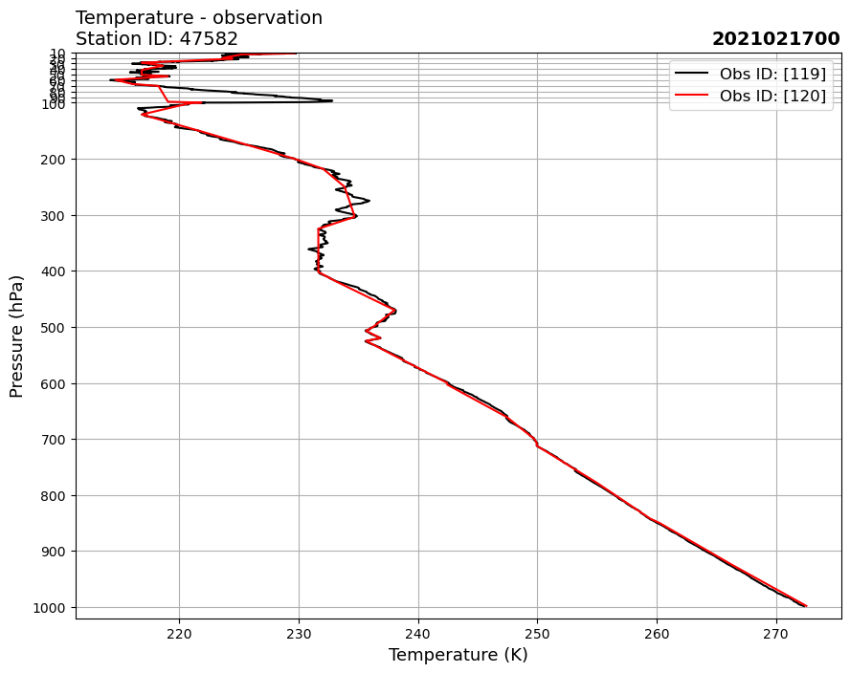

Slide 3
Advantages of this data
Time and location accurately included in the file (not estimated)
Observation values stored more accurately.
Data reported frequently in the vertical.
Descent data (after balloon burst) may also be included.
Data created automatically. Fewer Human errors.
All stations are supposed to transition to this form of data – some have switched and no longer report in old format.

Slide 4
Gotcha’s
Not all stations include all information
Some profiles are just translated into the new format.
Some profiles missing pressure at all levels and just have height
Many levels – requires different version of BUFRLIB (with dynamic allocation)
Descent profiles go from highest pressure to lowest can be distinguished by observation time.
Missing some prepbufr created flags

Slide 5
Details
Assigned data as new observation types
119 Temperature, moisture, surface pressure - ascent
118 Temperature, moisture – descent
219 Wind with associated pressure – ascent
218 Wind with height only – ascent
217 Wind (with pressure only) – descent
Did not do much work with ob error
Student with Kathy and Cory this summer
If < 100 levels same as now
If > 100 levels sum of square errors in layer equals error in input file
If both data with old format and new used - chose new profile based on ID
Data use determined by convinfo file

Slide 6
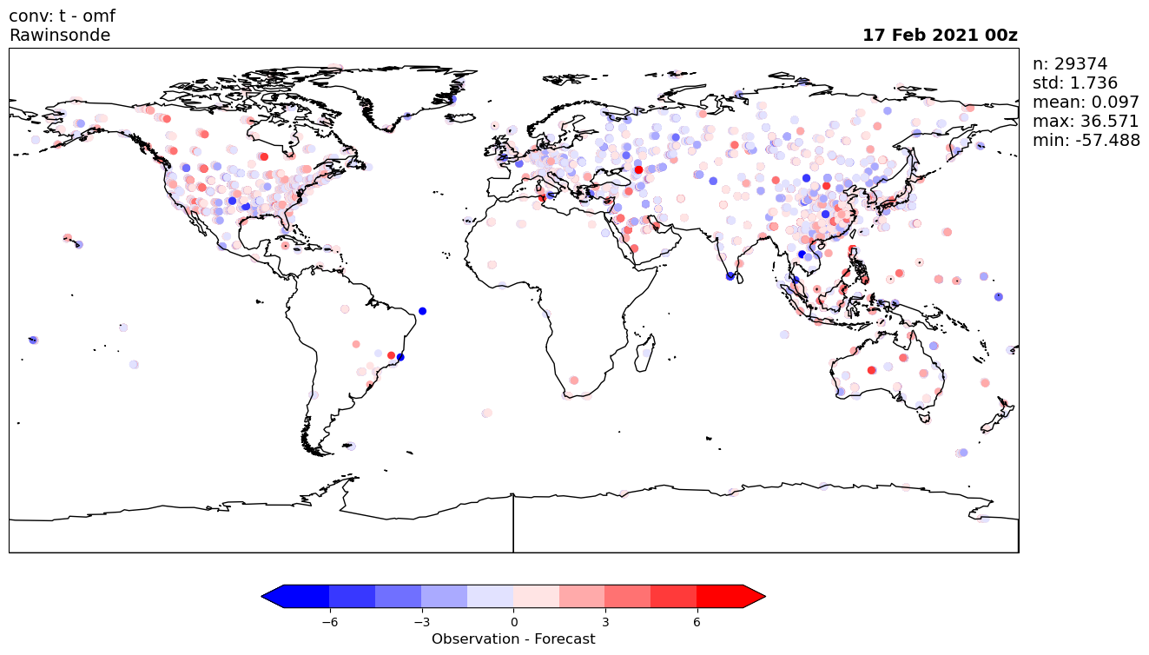

Slide 7
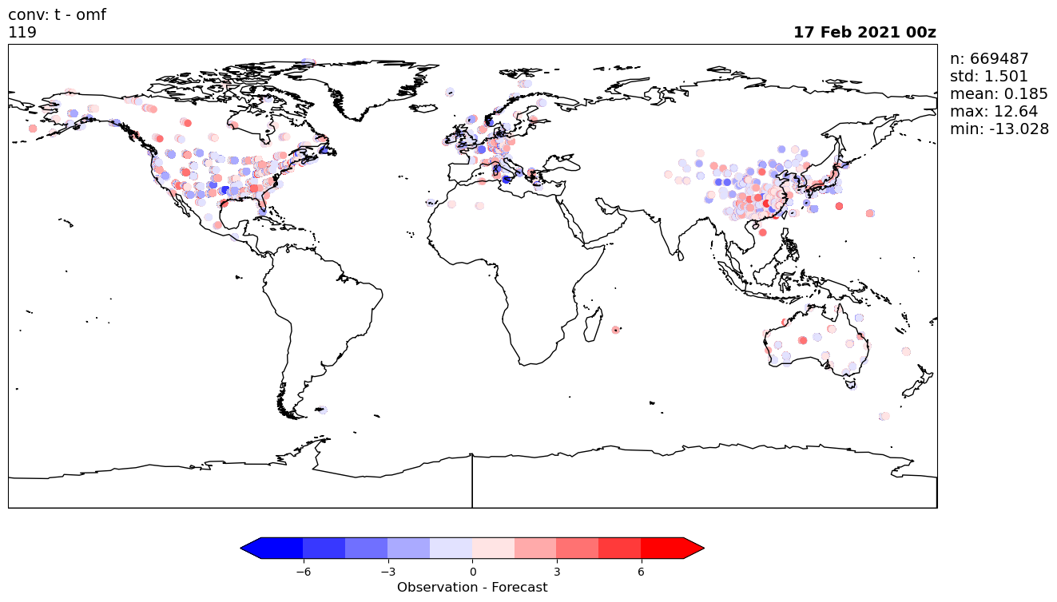

Slide 8
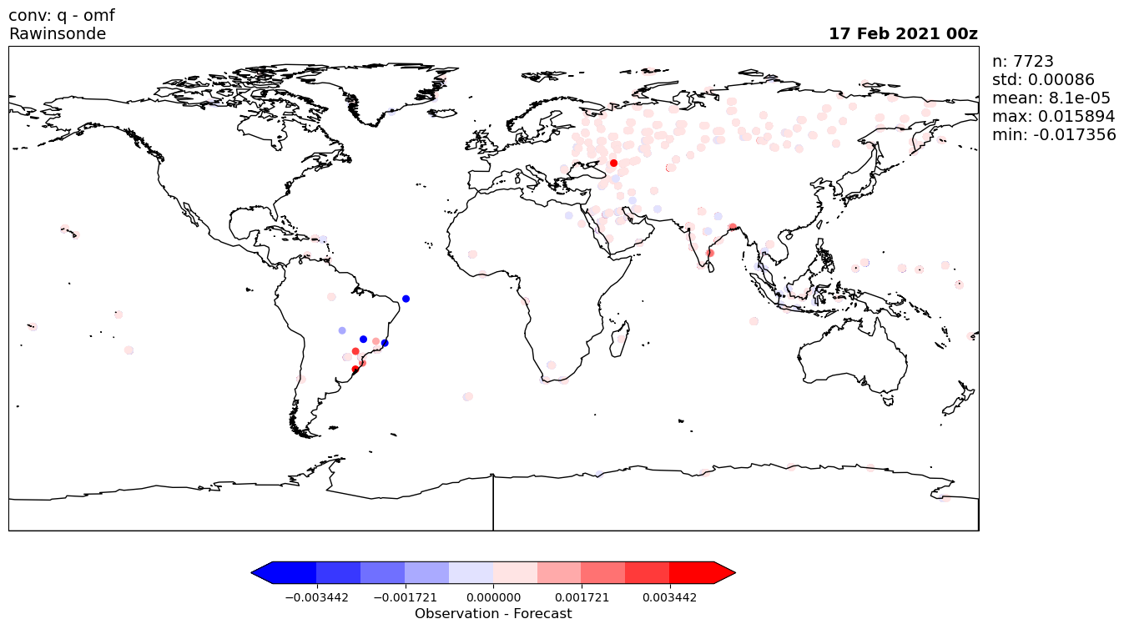

Slide 9
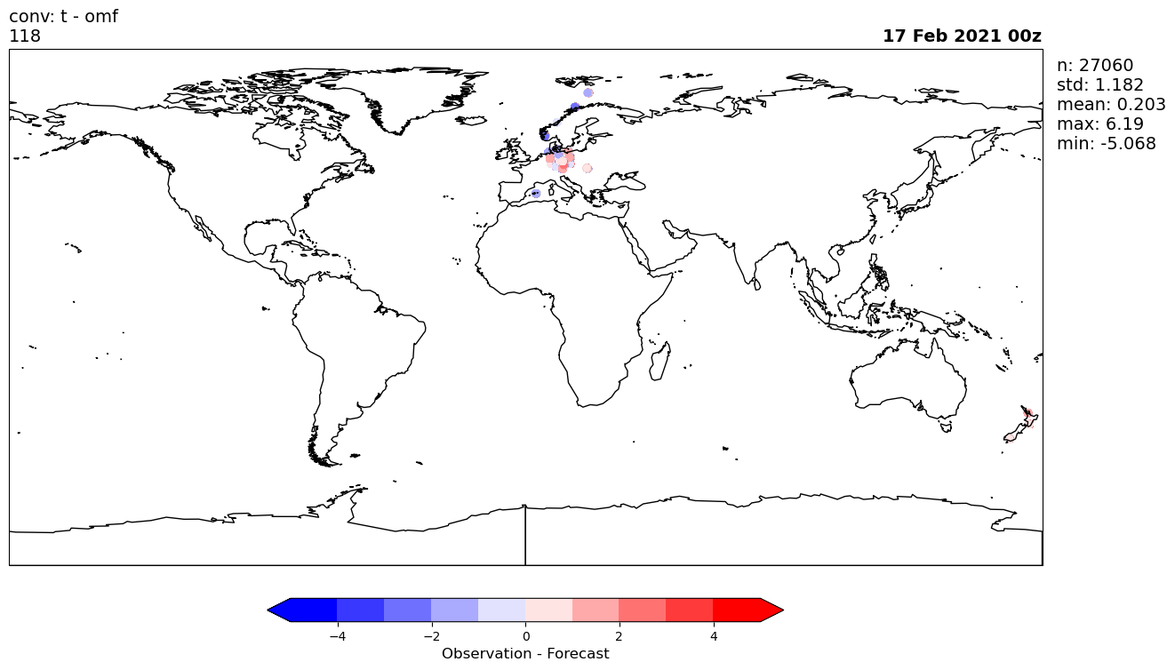

Slide 10
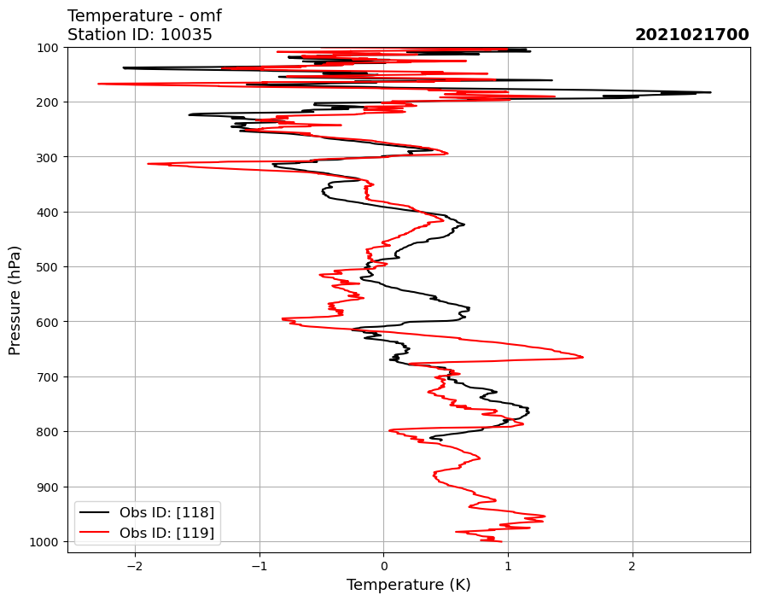
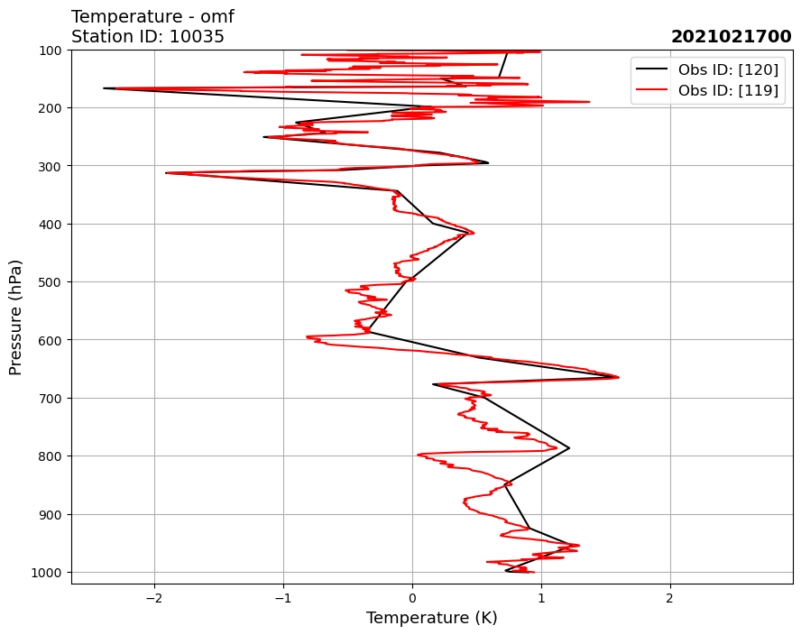

Slide 11
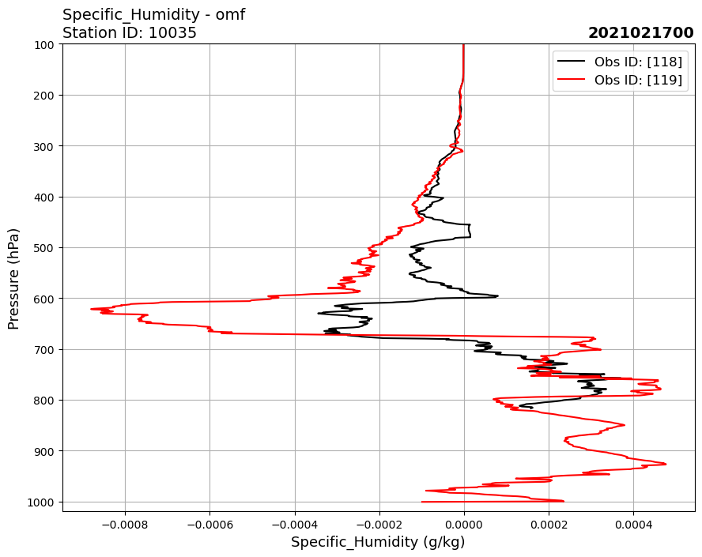
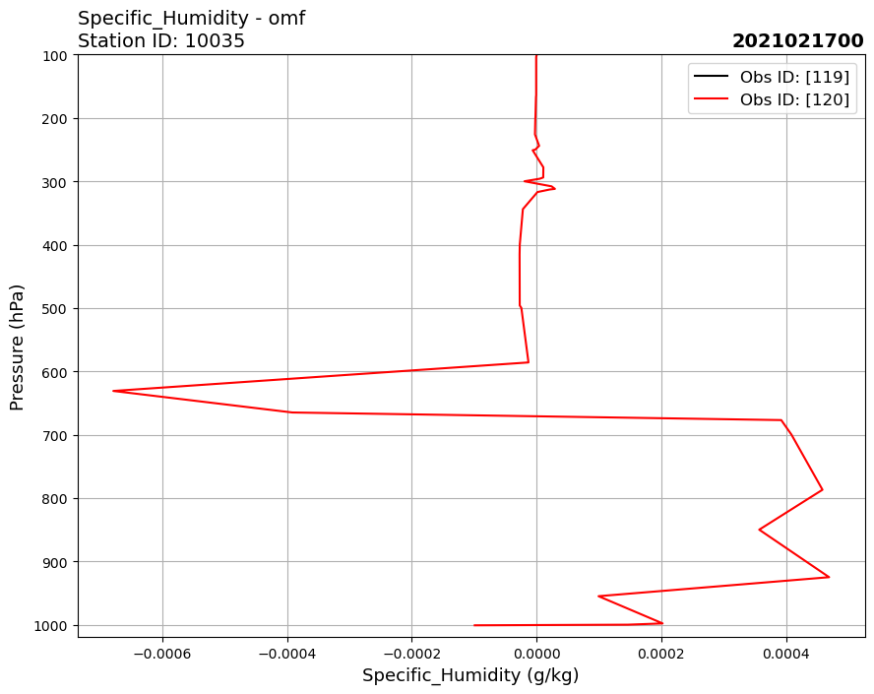

Slide 12
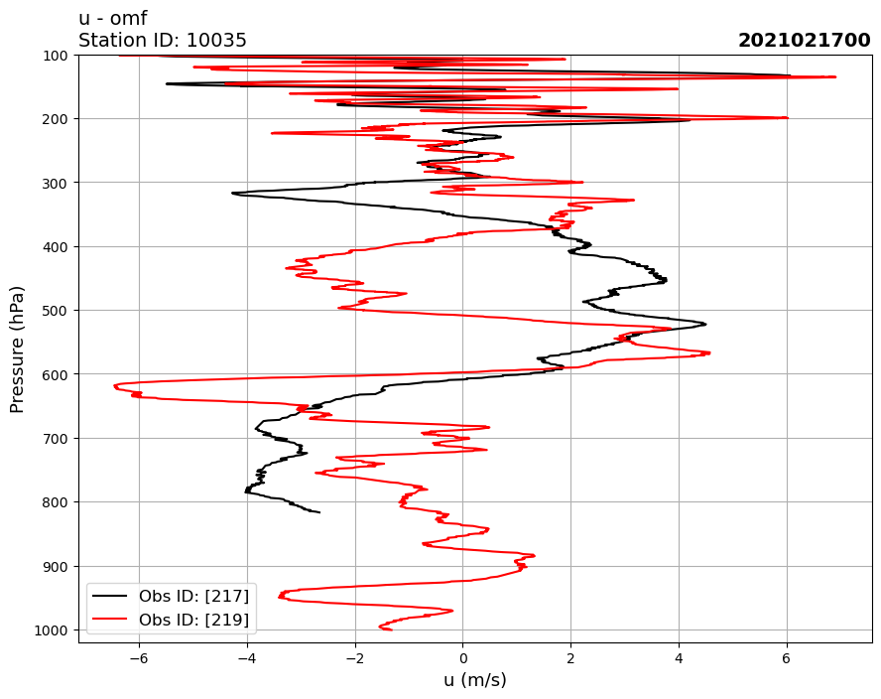
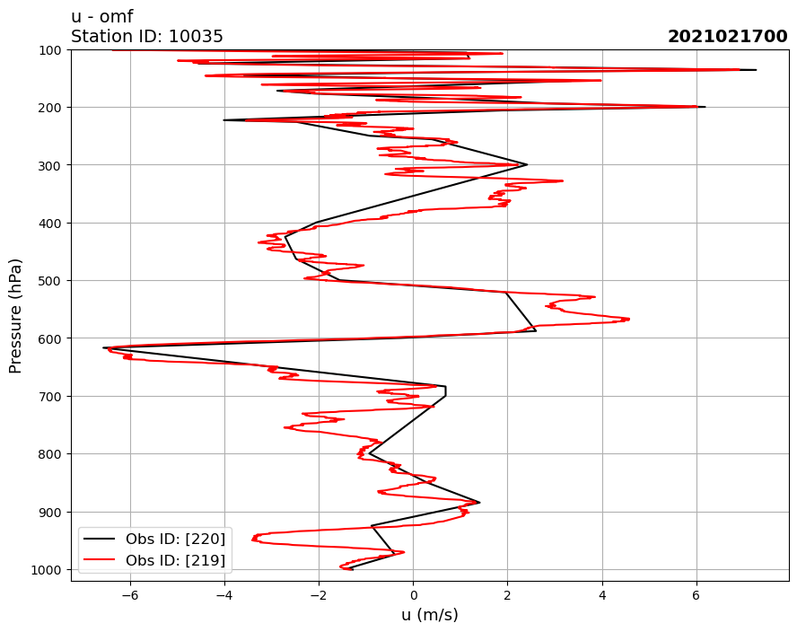

Slide 13
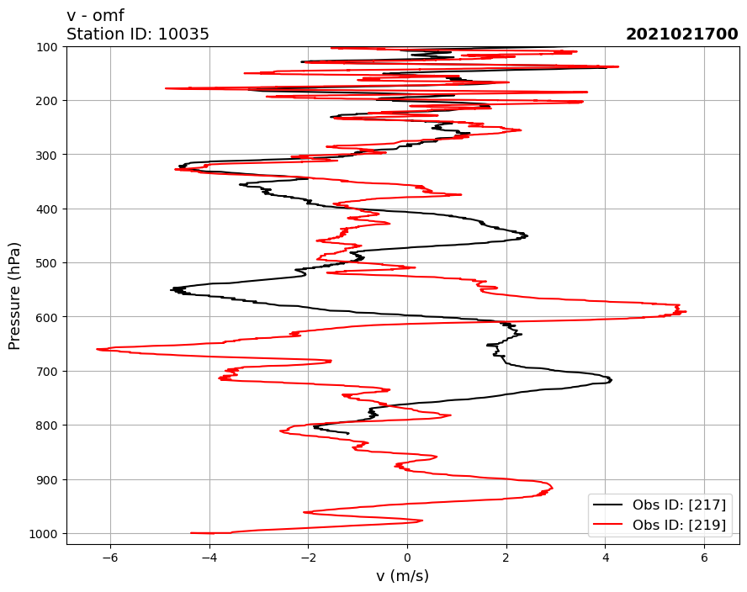
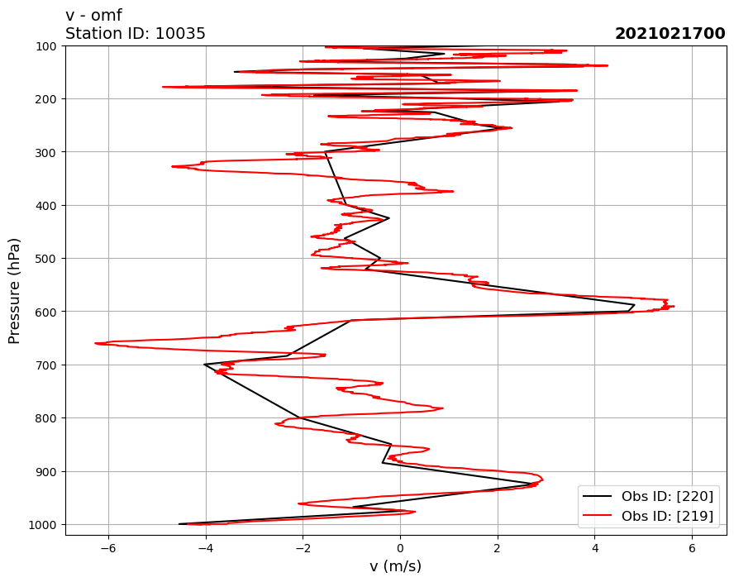

Slide 14
Moving forward
Inclusion of changes to trunk (mainly in new routine hdraobmod.f90)
Data into operations
Monitoring (currently needs head of trunk) in parallel or operations
Obs error update with summer student
Turn on in operations

