Slide 1
This is essentially the mixed layer depth. Expected results.
adic_intmld(i,j) = adic_intmld(i,j) + thickness%dzt(i,j,k)
Original equation was:
adic_intmld(i,j) = adic_intmld(i,j) + biotr(i,k,id_adic) * thickness%dzt(i,j,k)
So it’s not the issue of ‘thicknes%dzt’

Slide 2
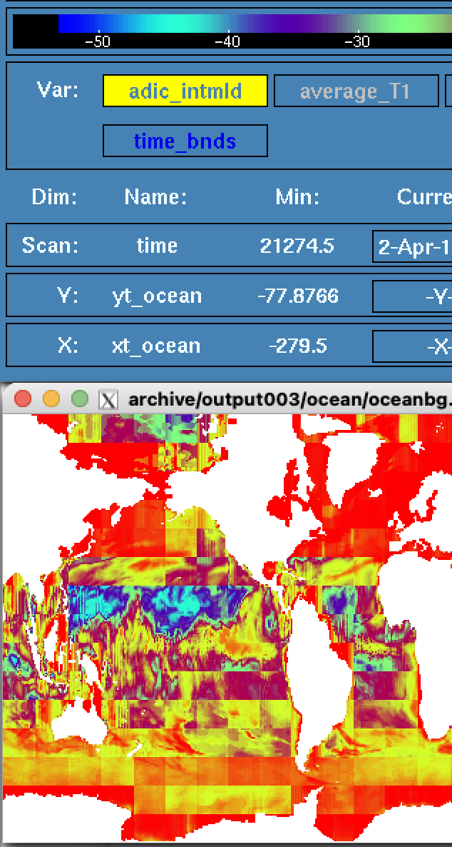
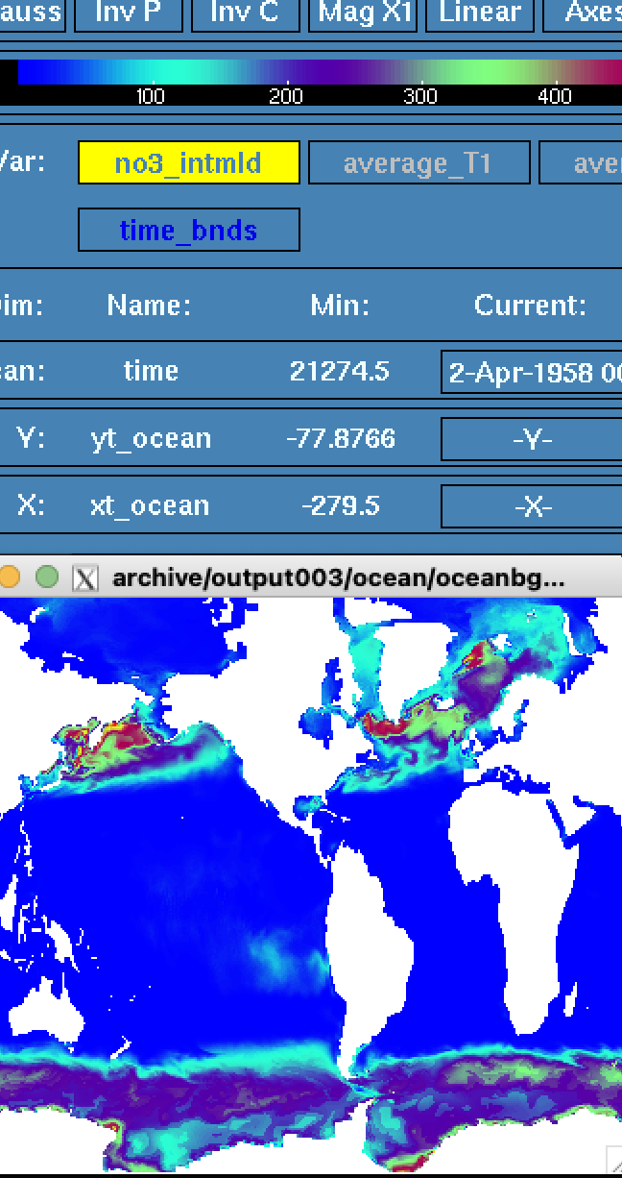
Biotr is negative? Why?
adic_intmld(i,j) = adic_intmld(i,j) + biotr(i,k,id_adic) !* thickness%dzt(i,j,k)
Distribution is patchy too (big blocks), so some issue with indexing I think. Use other variable maybe.
No3 looks file (right), no blocks exist..

Slide 3
Using t_prog instead of biotr helped!
adic_intmld(i,j) = adic_intmld(i,j) + t_prog(ind_adic)%field(i,j,k,time%taum1) !* thickness%dzt(i,j,k)
In bio_v3.F90, ‘biotr’ for alk/dic/adic is not computed.

Slide 4
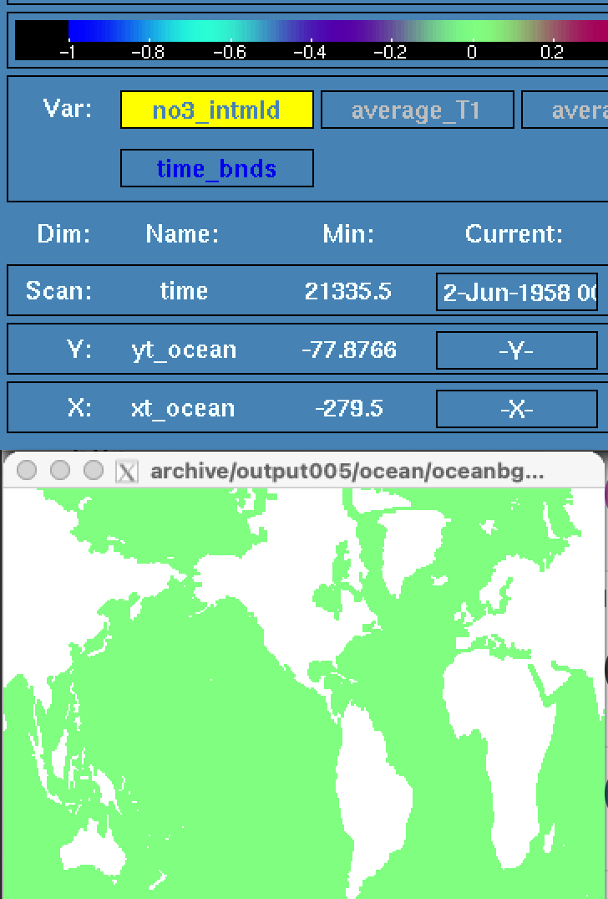
I confirm that this method works by comparing t_prog and biotr for no3
no3_intmld(i,j) = no3_intmld(i,j) + t_prog(ind_no3)%field(i,j,k,time%taum1) - biotr(i,k,id_no3) !* thickness%dzt(i,j,k)
t_prog minus biotr is zero everywhere, meaning that t_prog can be used instead of biotr for other tracers.

