Slide 1
Sea Ice Biases: Diagnosing the behavior of Surface Flux Convergence
The concern: the iterative loop in the sea ice column package that calculates T*, U*, Q* (for each sea ice thickness category) oscillates or never converges ….
Possible cause for biases in the sea ice.
The conclusion: Flux calculation appears to be working…but noticed some interesting behaviors in thinnest and thickest sea ice categories.

Slide 2
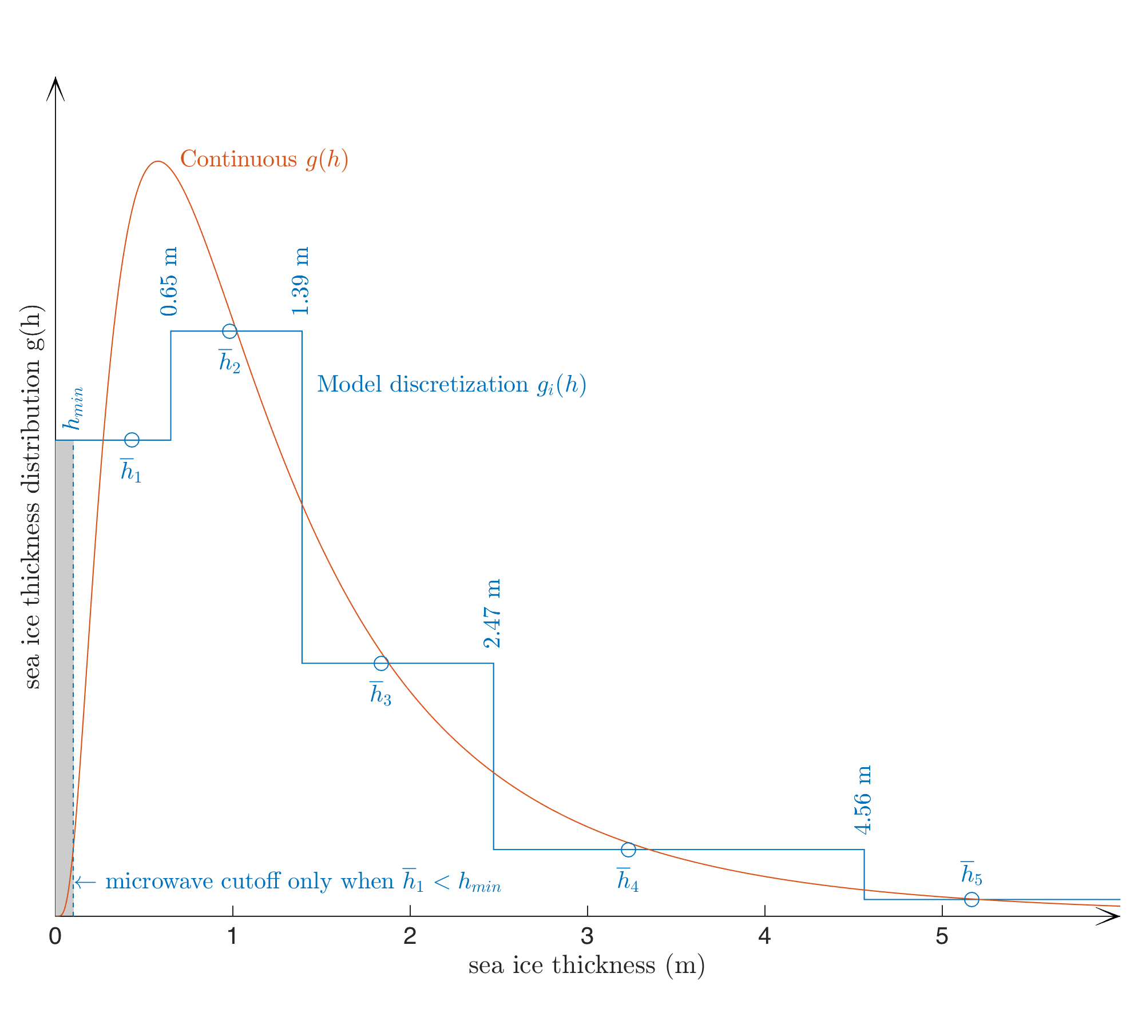
Some extra details:
D-Case (Stand Alone MPAS-SI) + B-Case (fully coupled)
2 year runs from cold start. Only looking at year 2 data
High-frequency sea ice turbulent flux coupling turned ON
Turb flux calculation performed in sea ice column package
Iterative Flux calculation:
# of loop iterations <= 10
if convergence reached loop exits before 10
Loop called for each ice thickness category (N=5)
ustar = rd * vmag
exchange coeff momentum * magnitude sfc wind
tstar = rh * delt
exchange coeff heat * potential T difference
qstar = re * delq
exchange coeff water * humidity difference

Slide 3
Locations selected for testing: both Perennial and MIZ

Slide 4
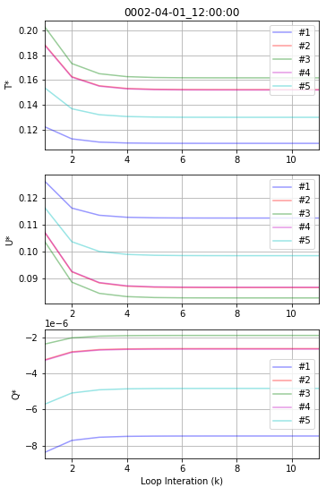
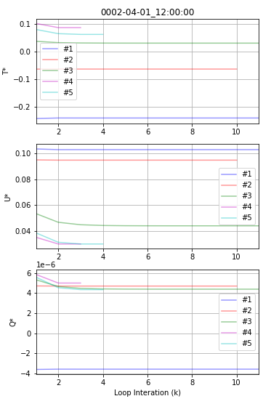
Stand Alone MPAS–SI (E3SM D-Case) Convergence within loop T*(top) U*(middle) Q*(bottom)
Location #1 – Antarctic
Location #9 – Arctic

Slide 5
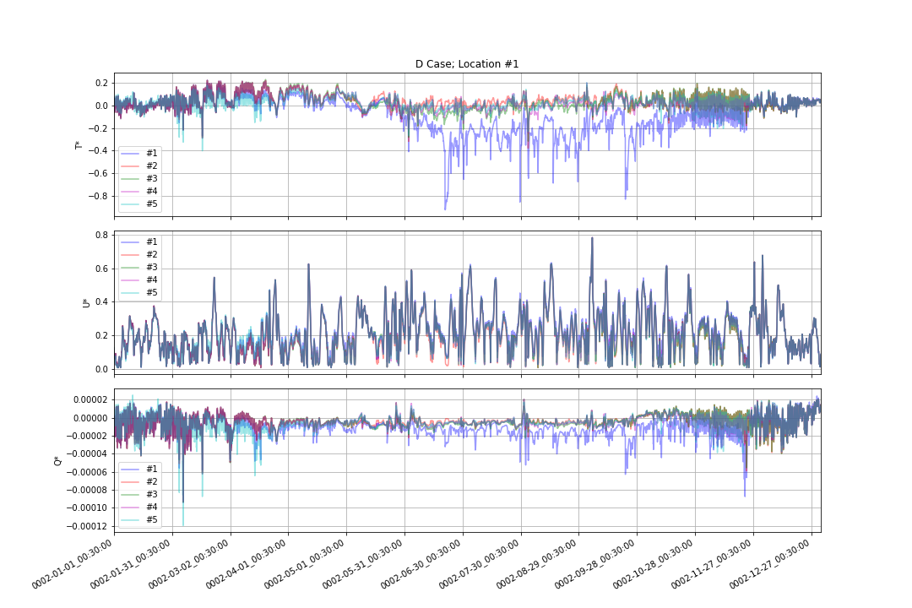
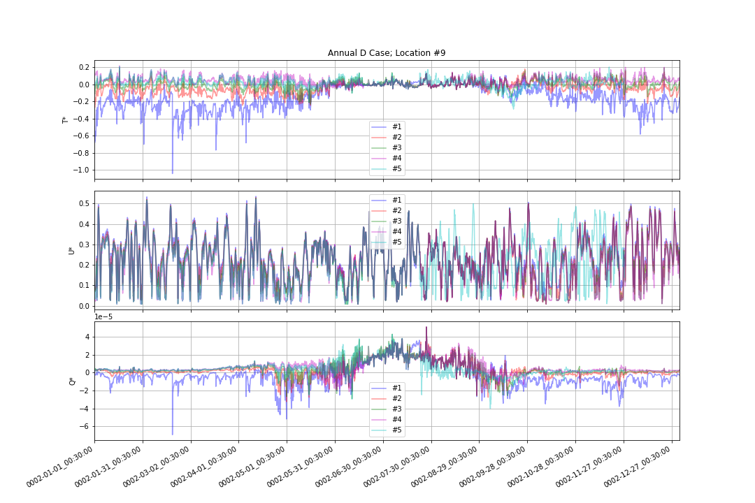
Stand Alone MPAS–SI Case Annual Time series
JAN
JULY
Location #1 Antarctic
Location #9 Arctic

Slide 6
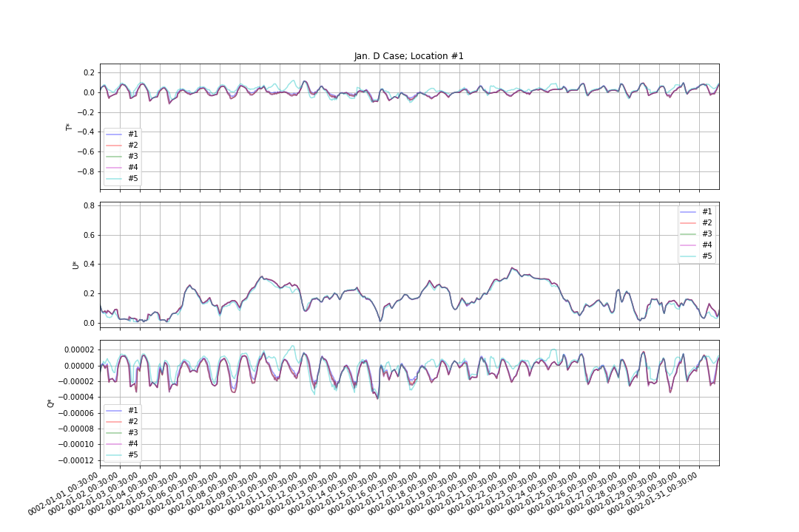
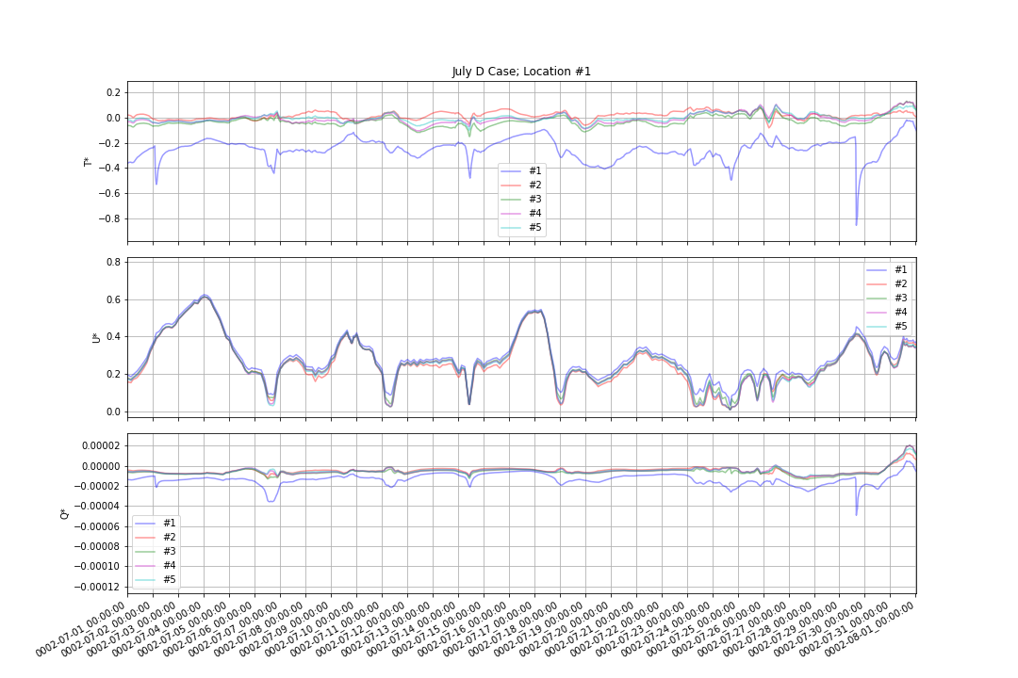
January Location #1 Antarctic
July Location #1 Antarctic

Slide 7
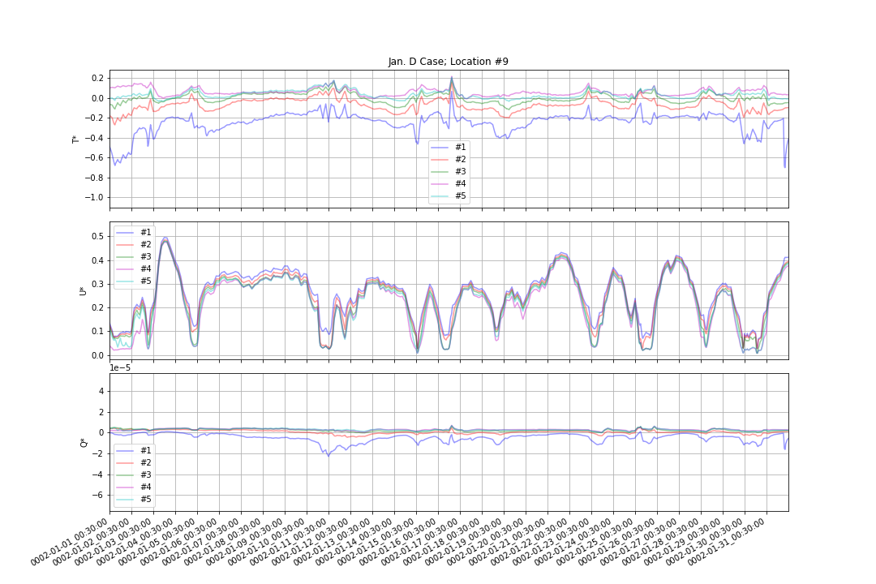
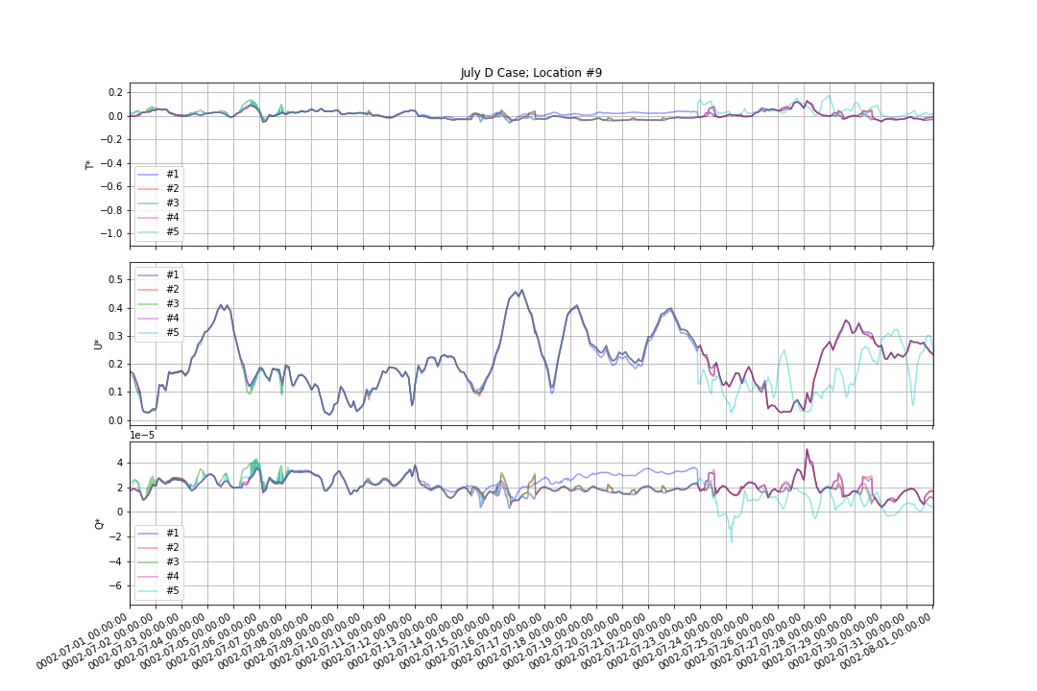
January Location #9 Arctic
July Location #9 Arctic

Slide 8
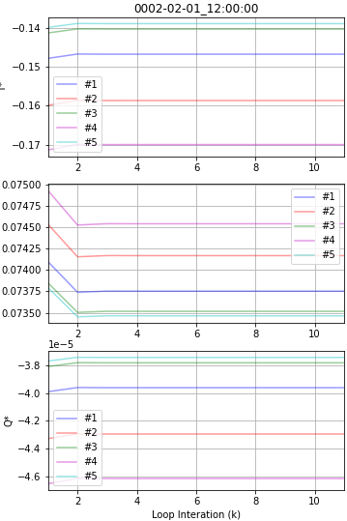
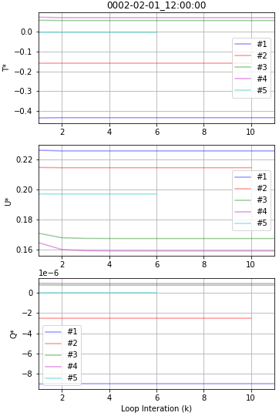
Location #1 – Antarctic
Location #9 – Arctic
Fully Coupled
(E3SM B – Case) Convergence within loop T*(top)
U*(middle)
Q*(bottom)

Slide 9
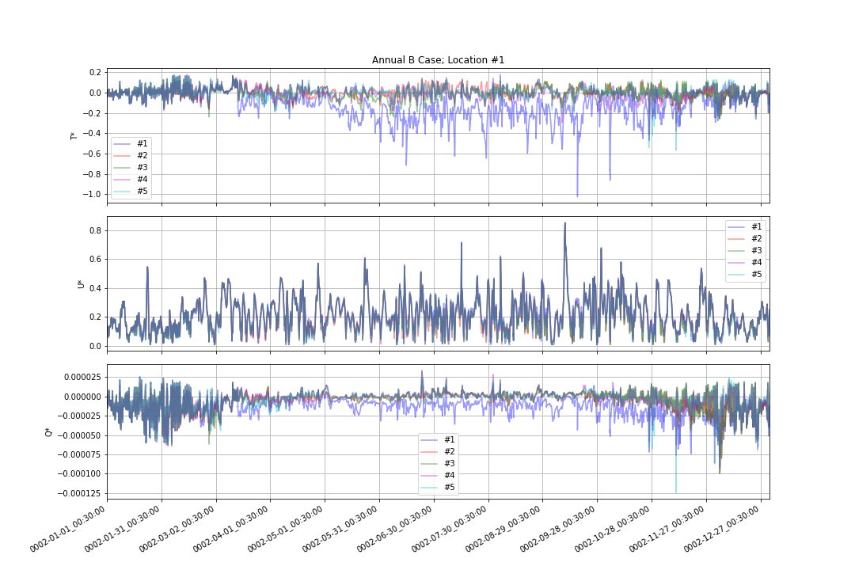
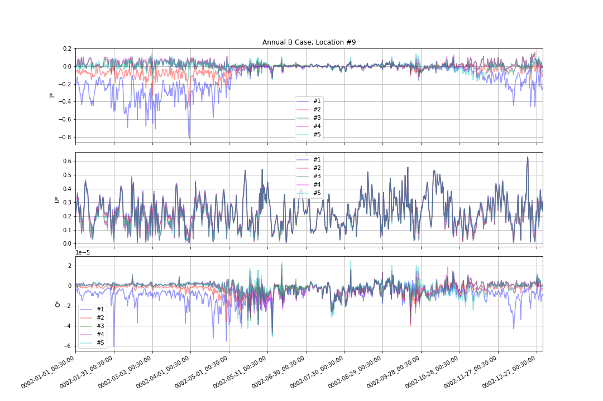
Fully Coupled E3SM B – Case Annual Timeseries
Location #1 Antarctic
Location #9 Arctic

Slide 10
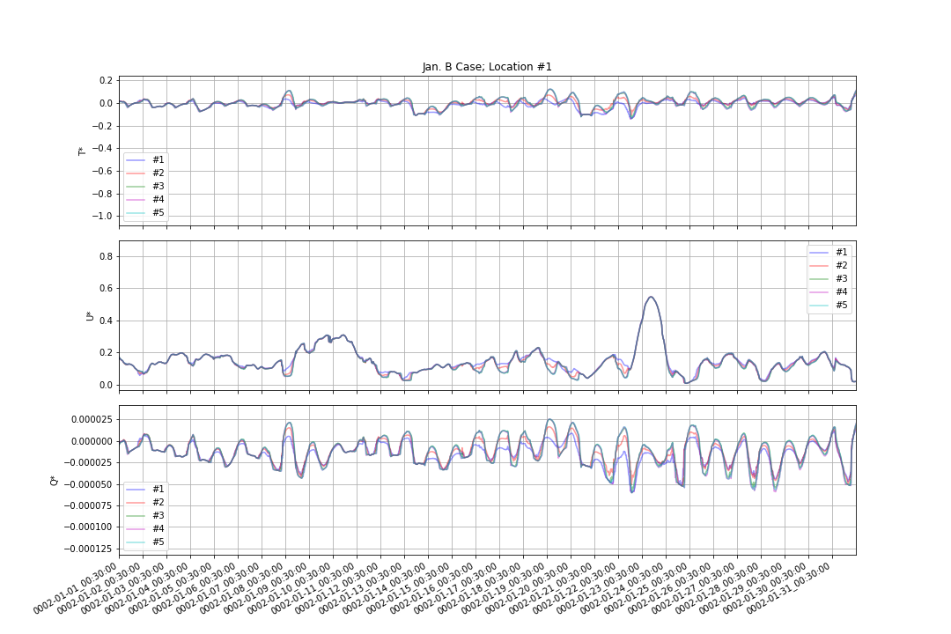
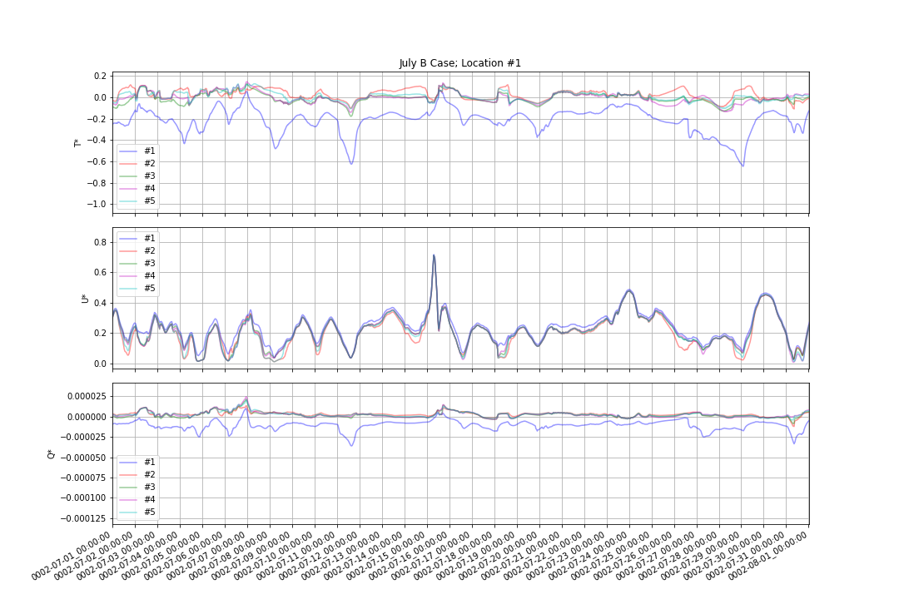
January Location #1 Antarctic
July Location #1 Antarctic

Slide 11
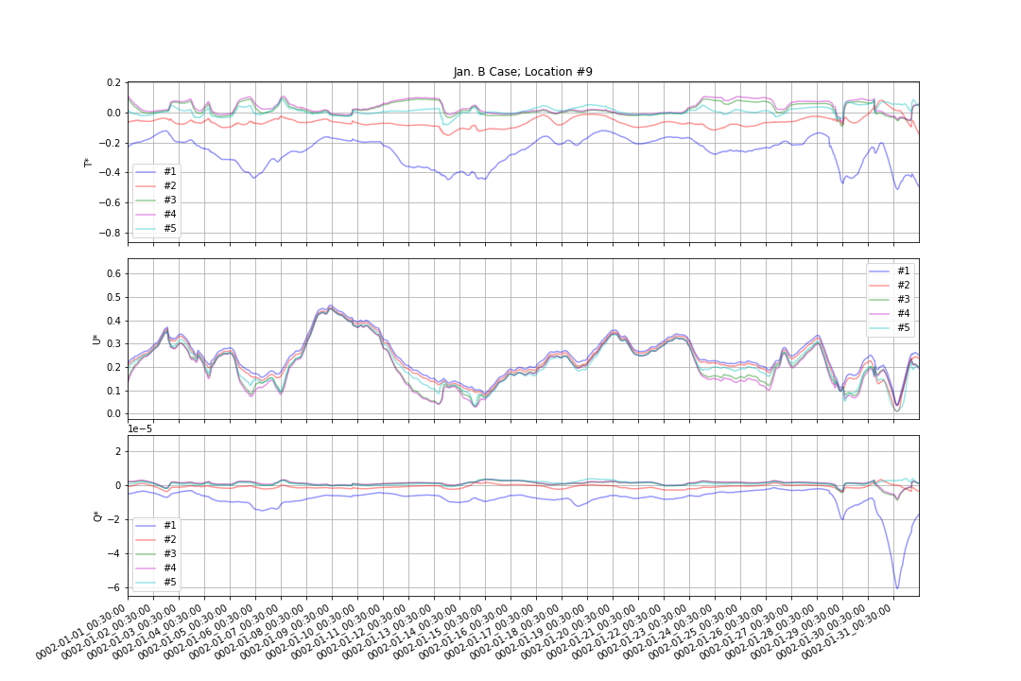
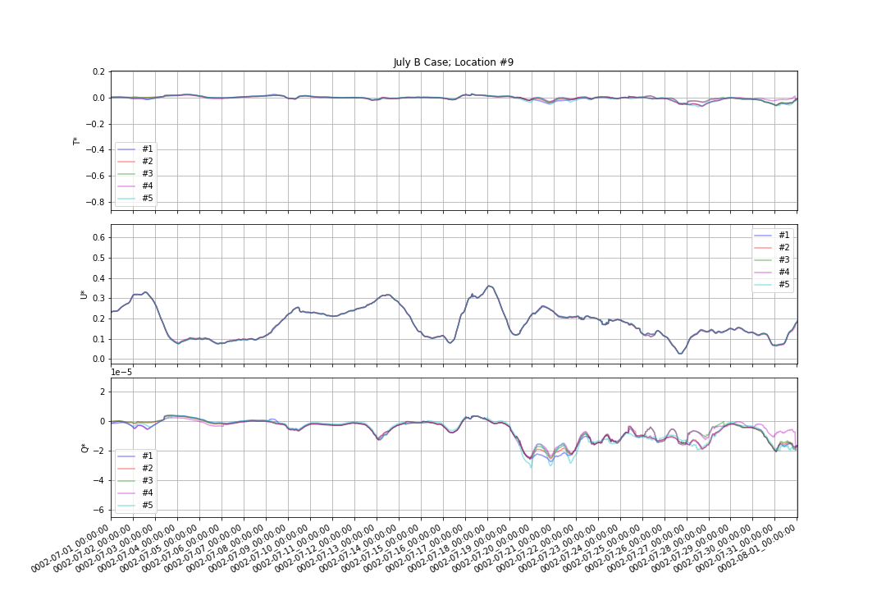
January Location #9 Arctic
July Location #9 Arctic

Slide 12
Conclusions
Flux calculations appear to be working
T* / U* / Q* values converge as expected
However, thinnest and thickest ice categories do show some odd behaviors….
In MPAS-SI Only Runs (D case)
Thinnest category jumps around in winter
Antarctic Locations = July
Arctic Locations = January
Thickest Ice Category jumps around in summer
Antarctic Locations = January
Arctic Locations = July
In Fully Coupled Runs (B case)
Thinnest category jumps around in winter
Antarctic Locations = July
Arctic Locations = January

